Slide 1
GIT, Maven & Jenkins

Slide 2
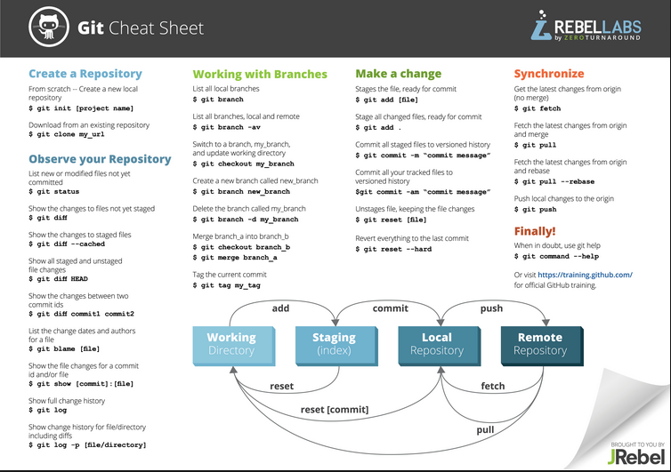

Slide 3
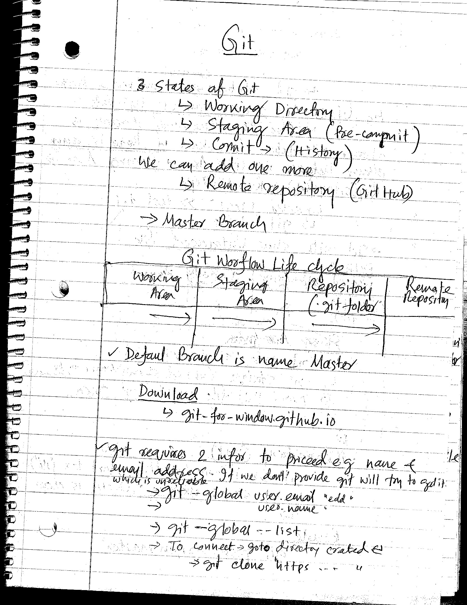
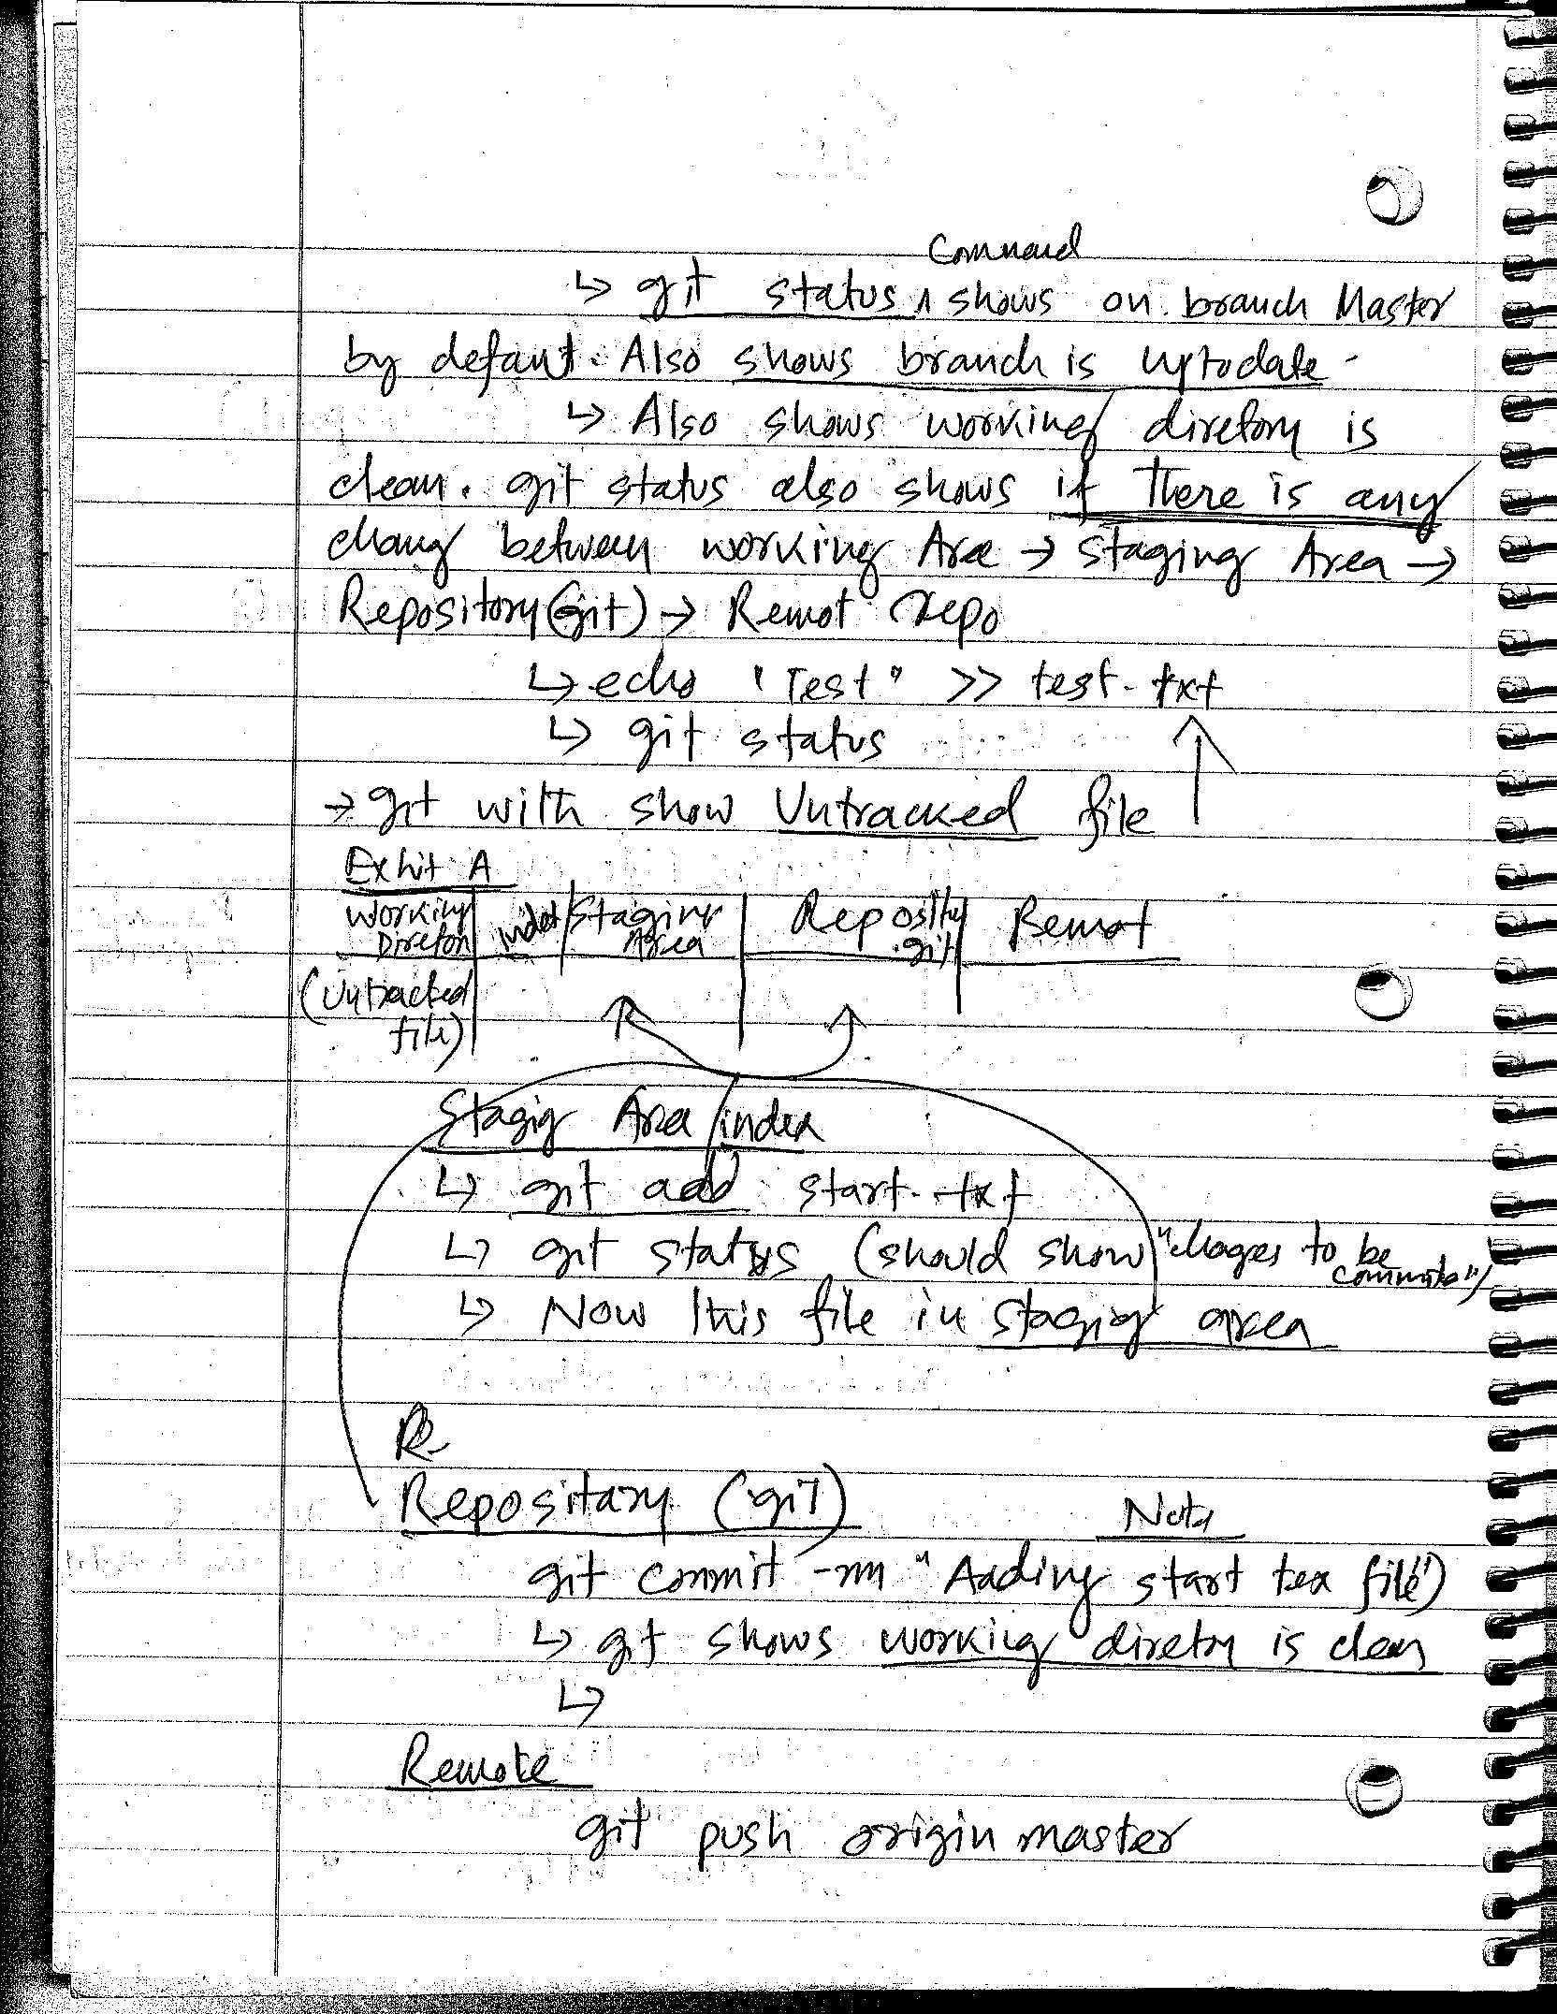

Slide 4
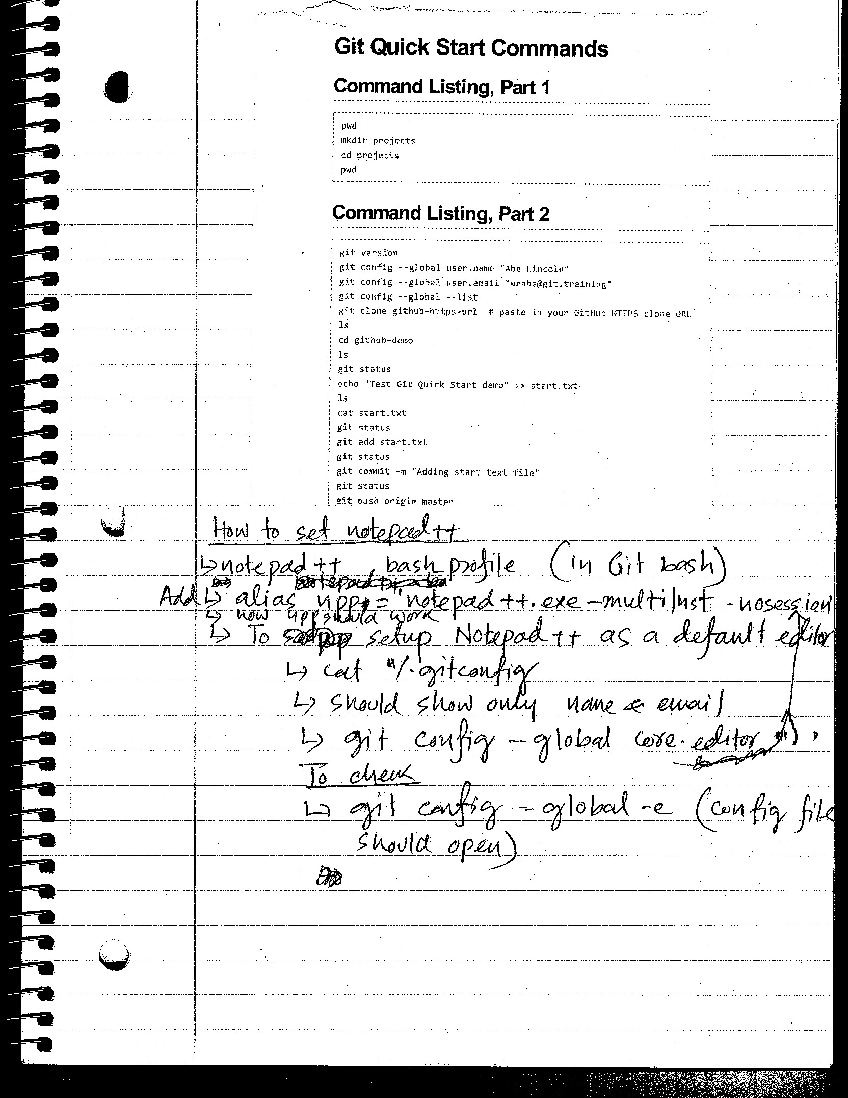
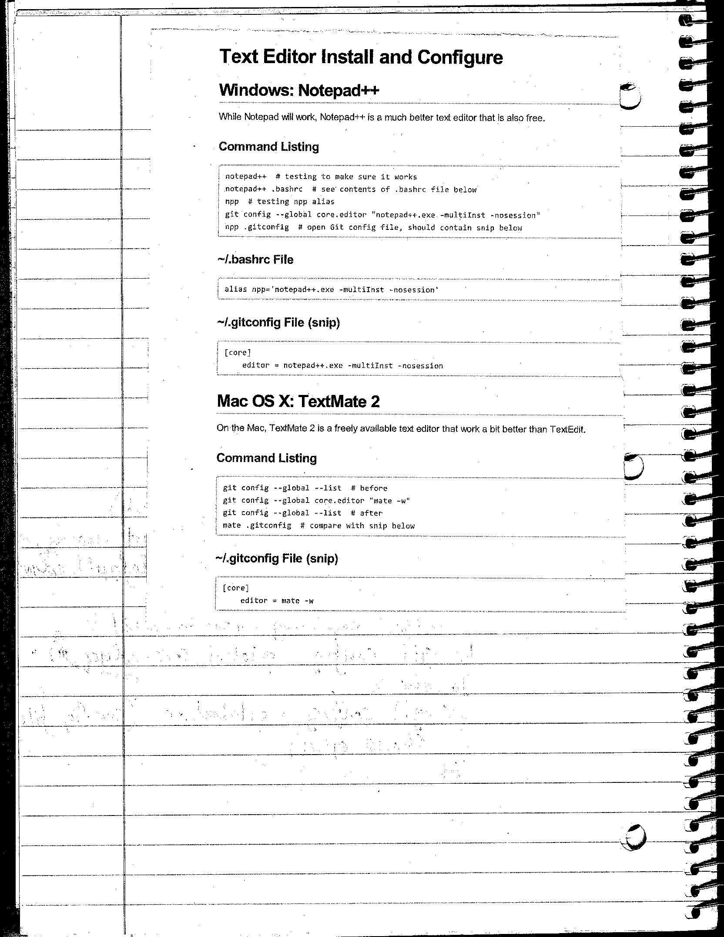

Slide 5
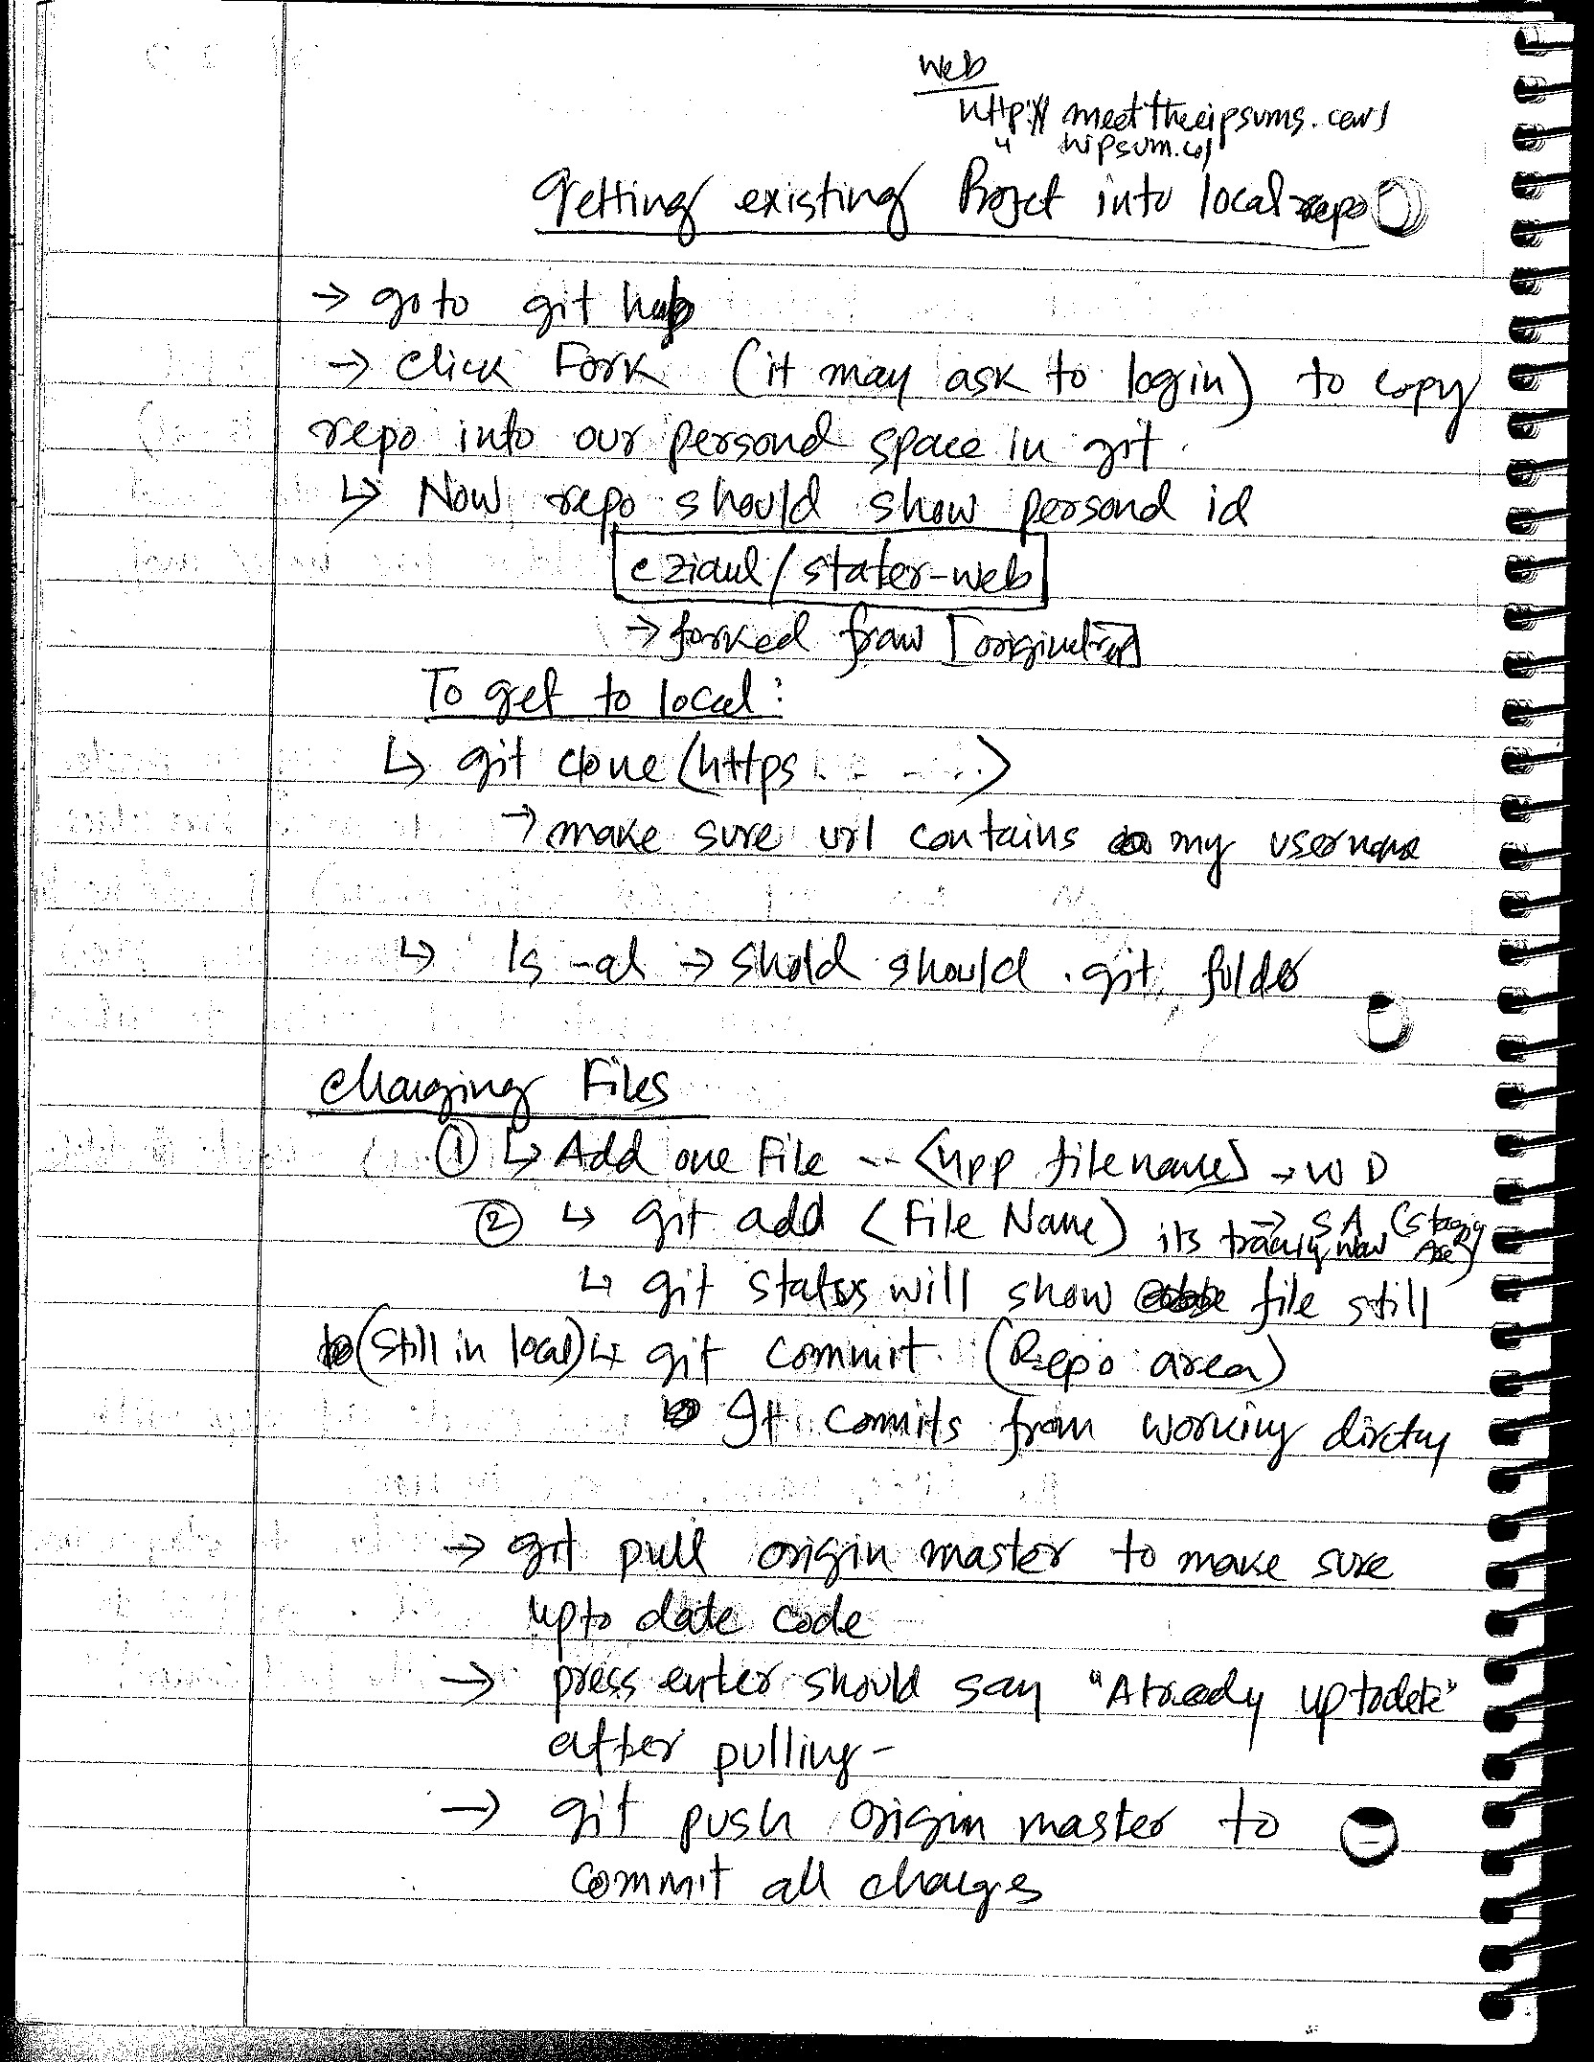
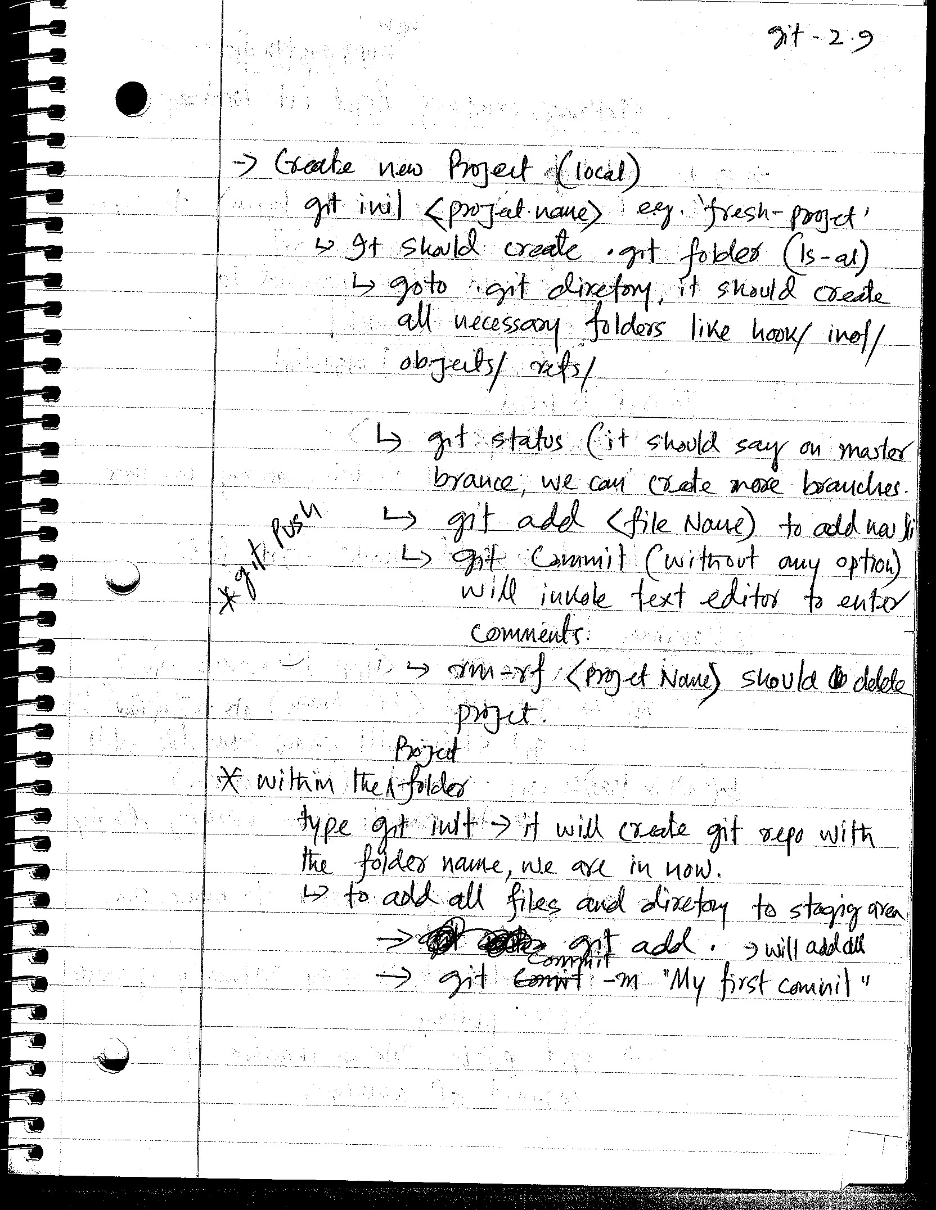

Slide 6
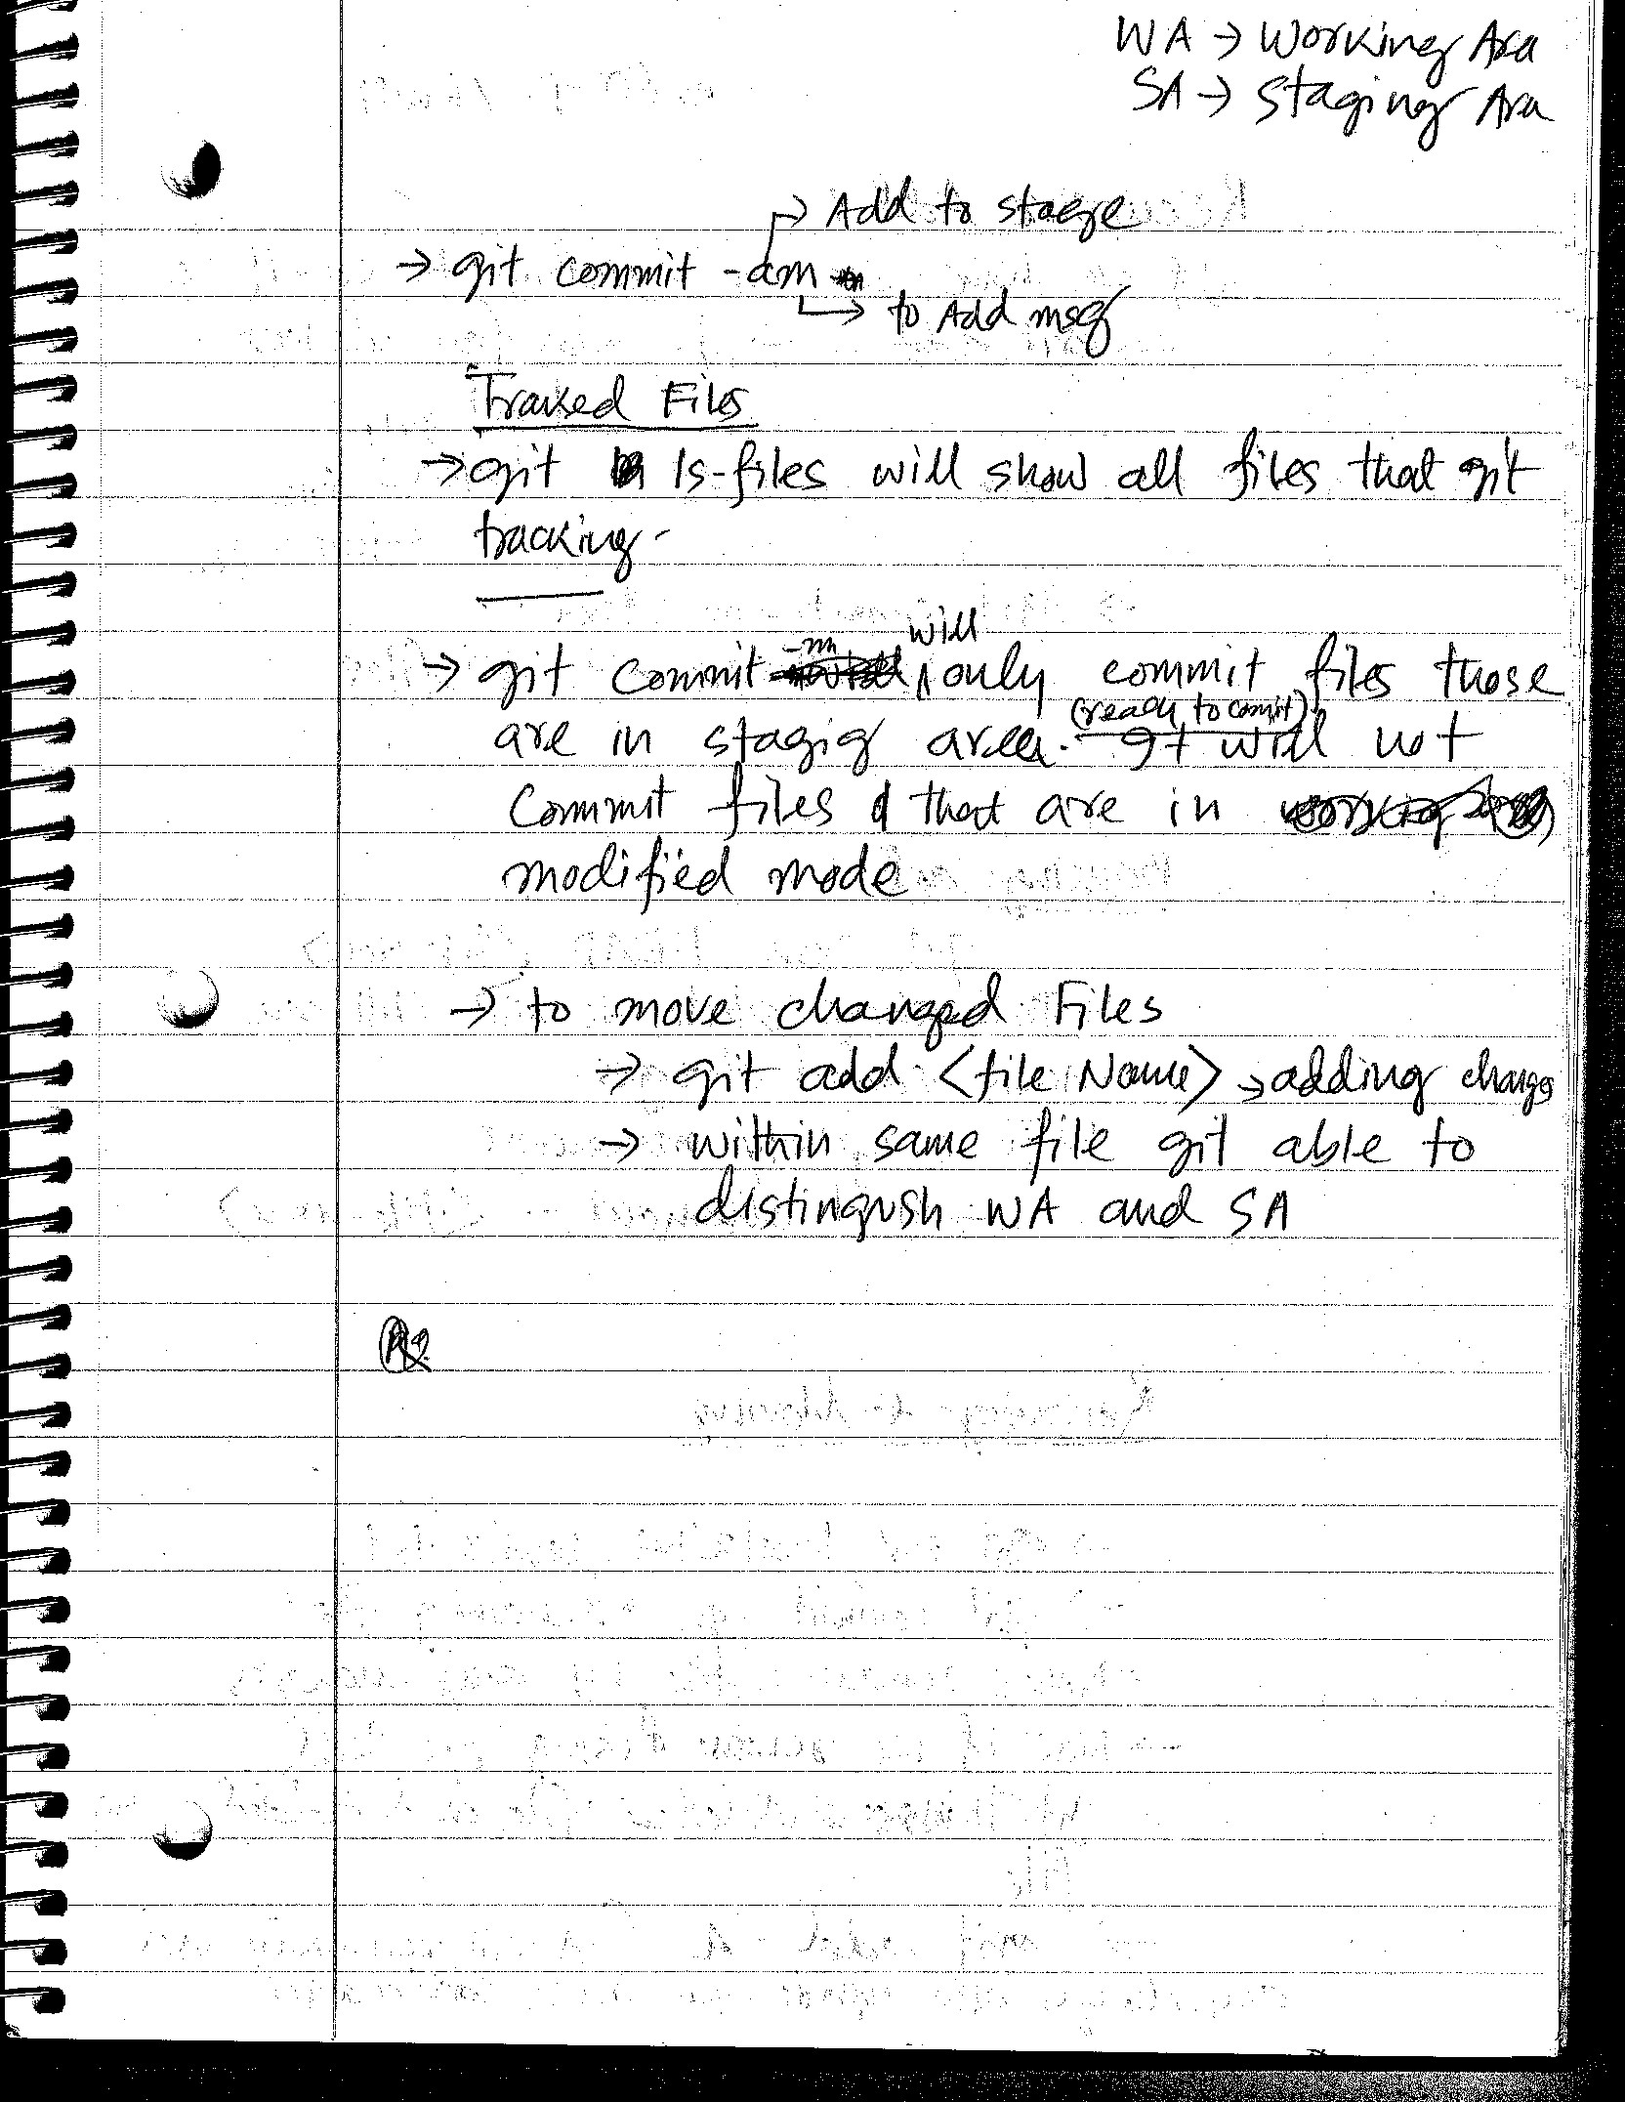
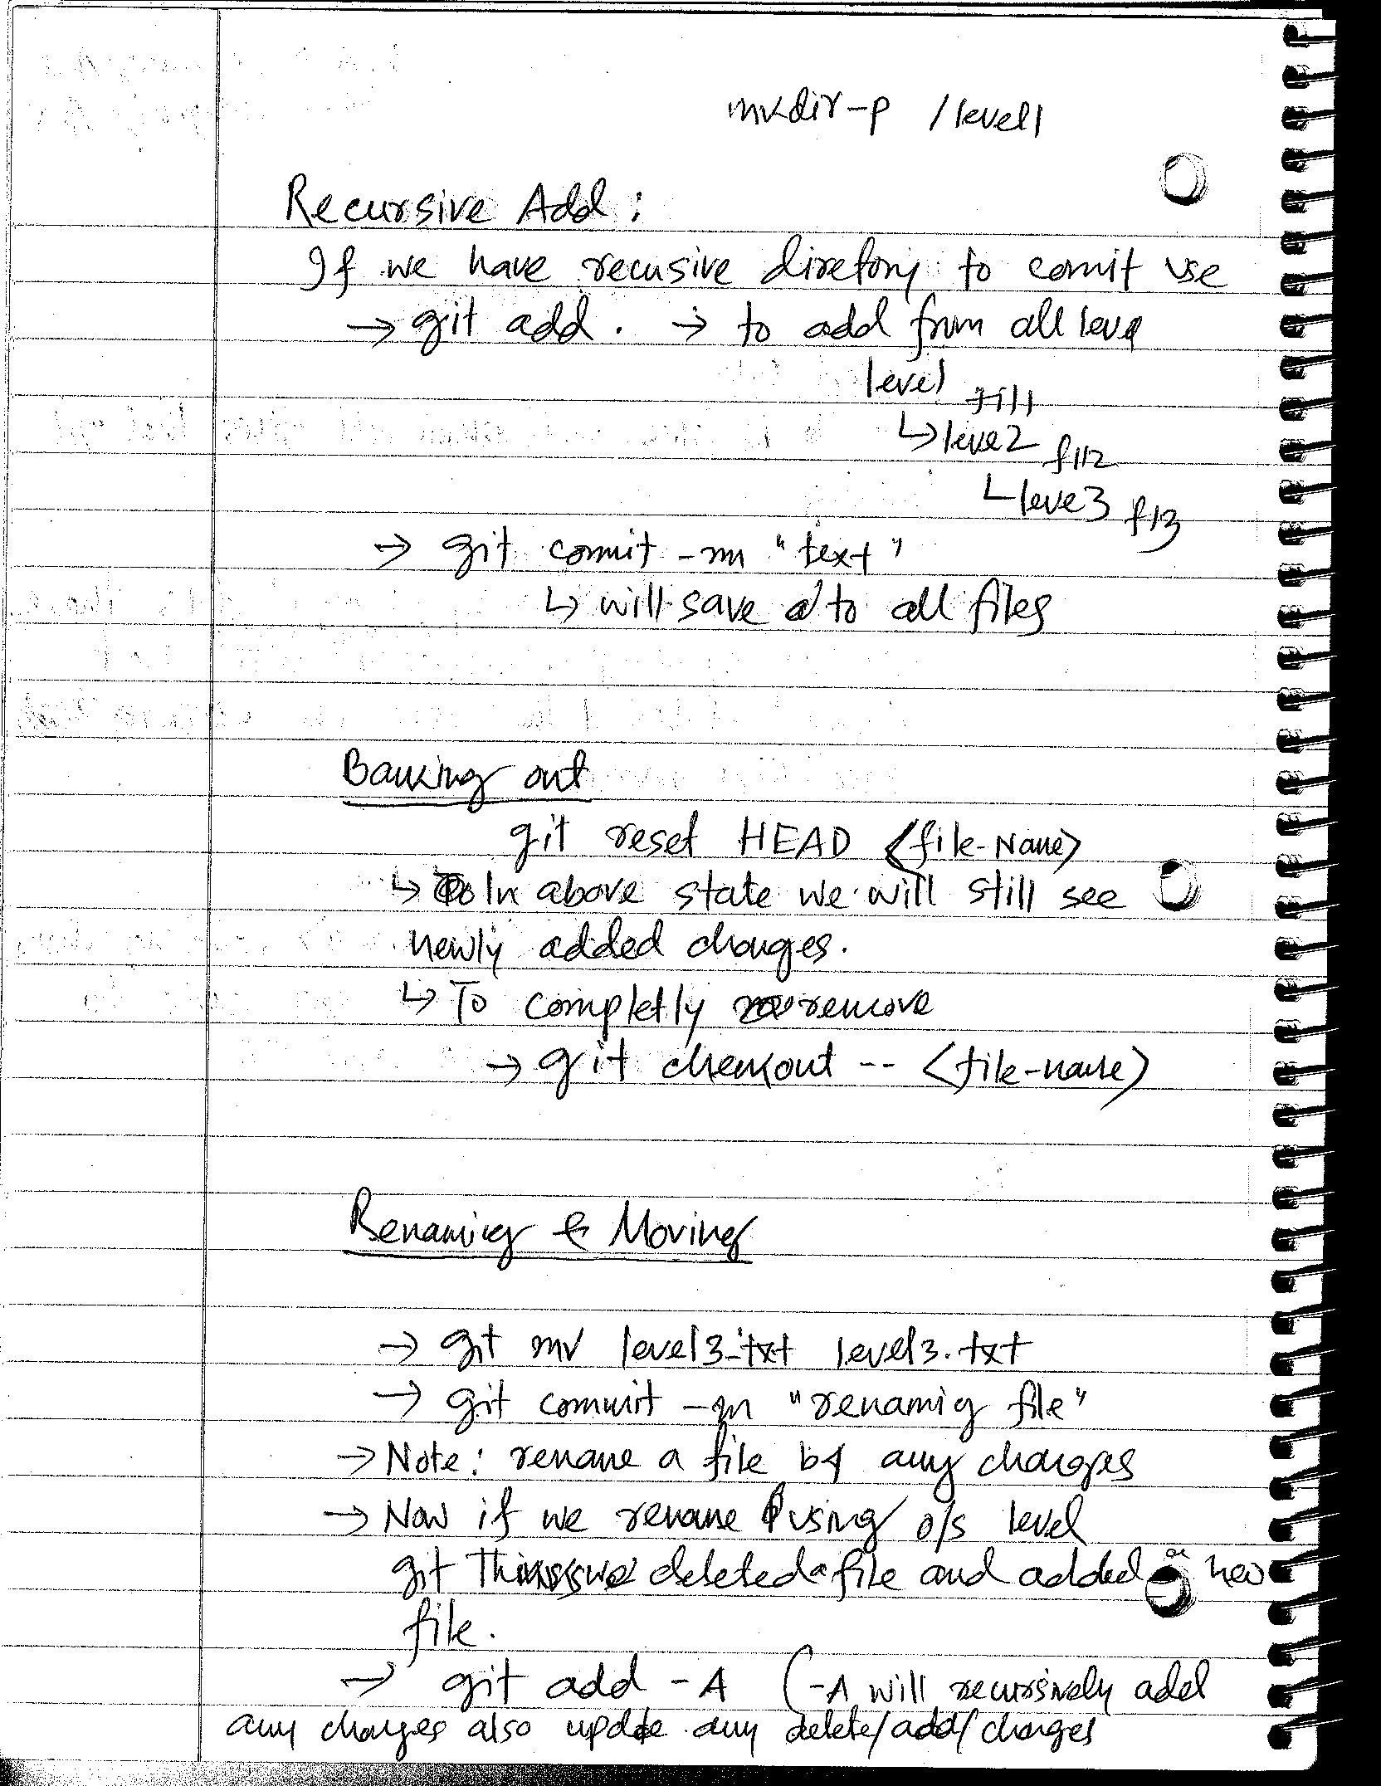

Slide 7
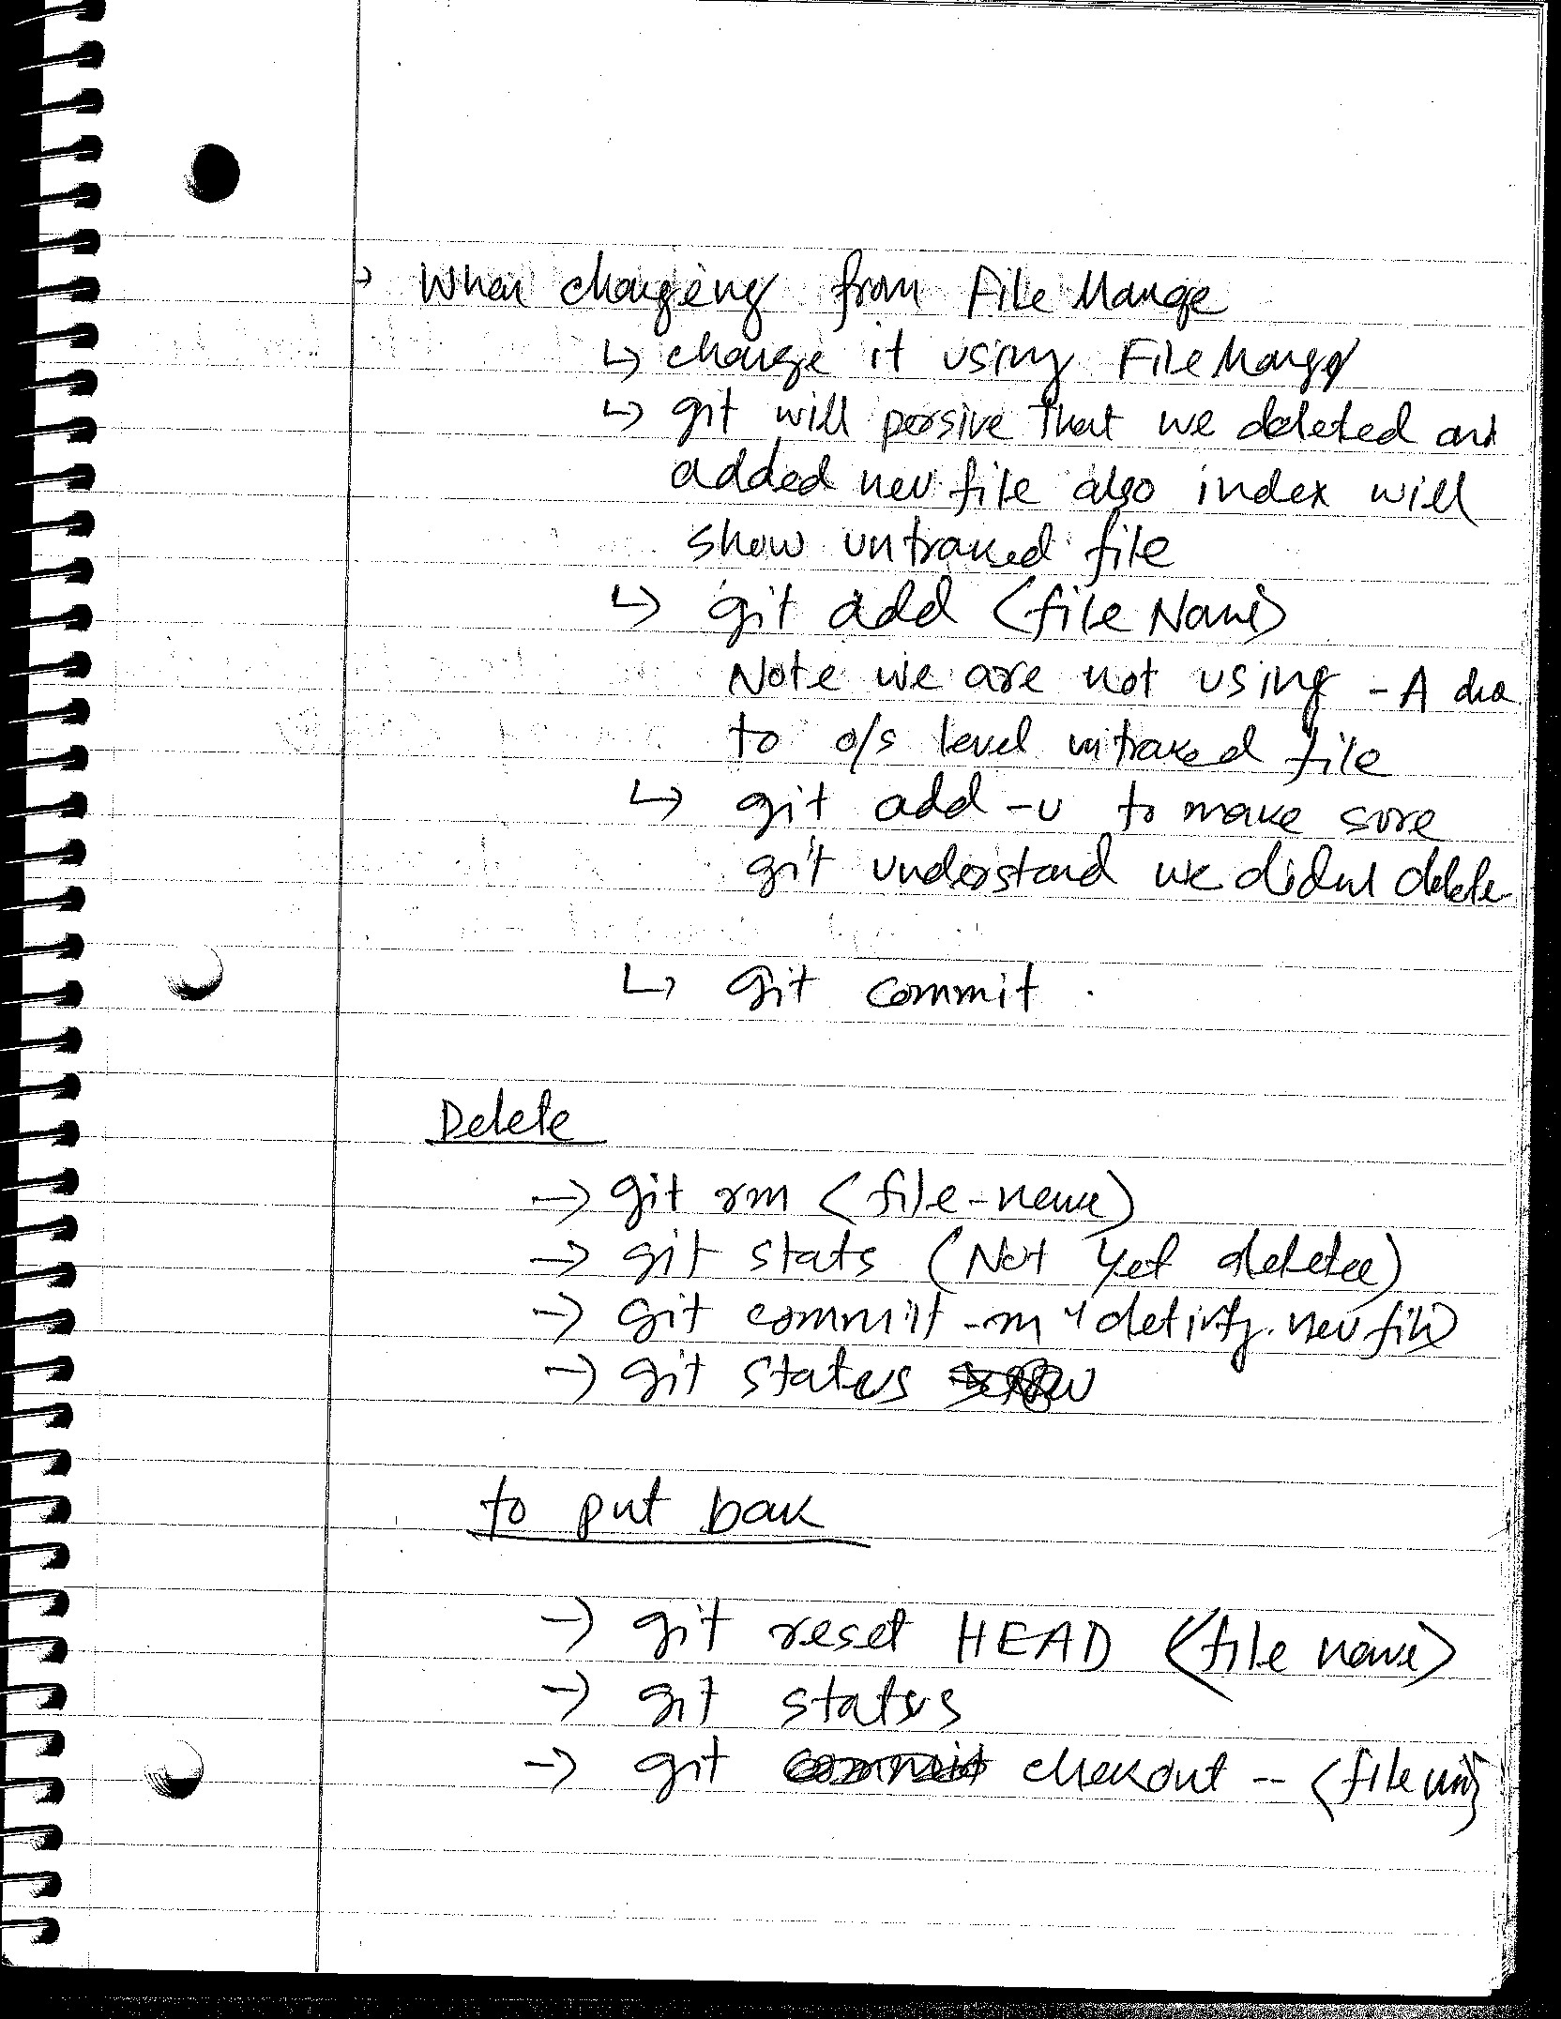
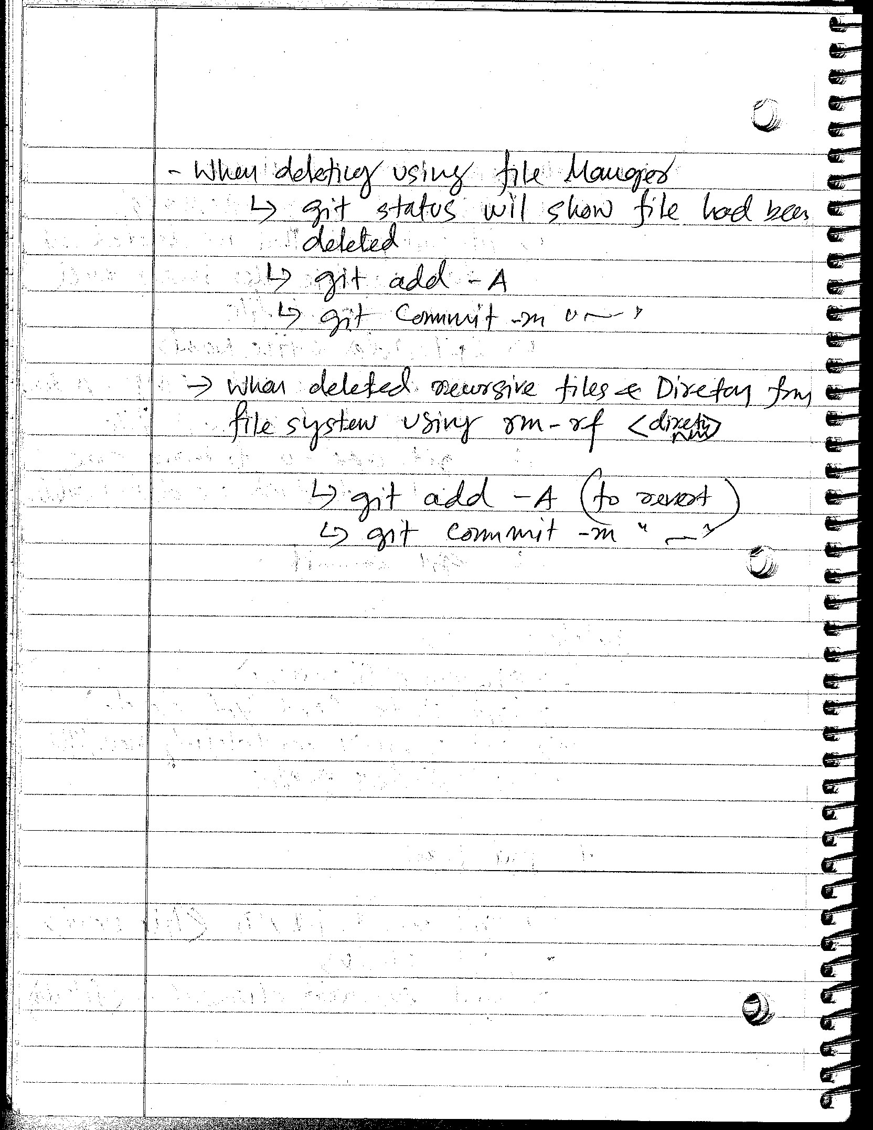

Slide 8
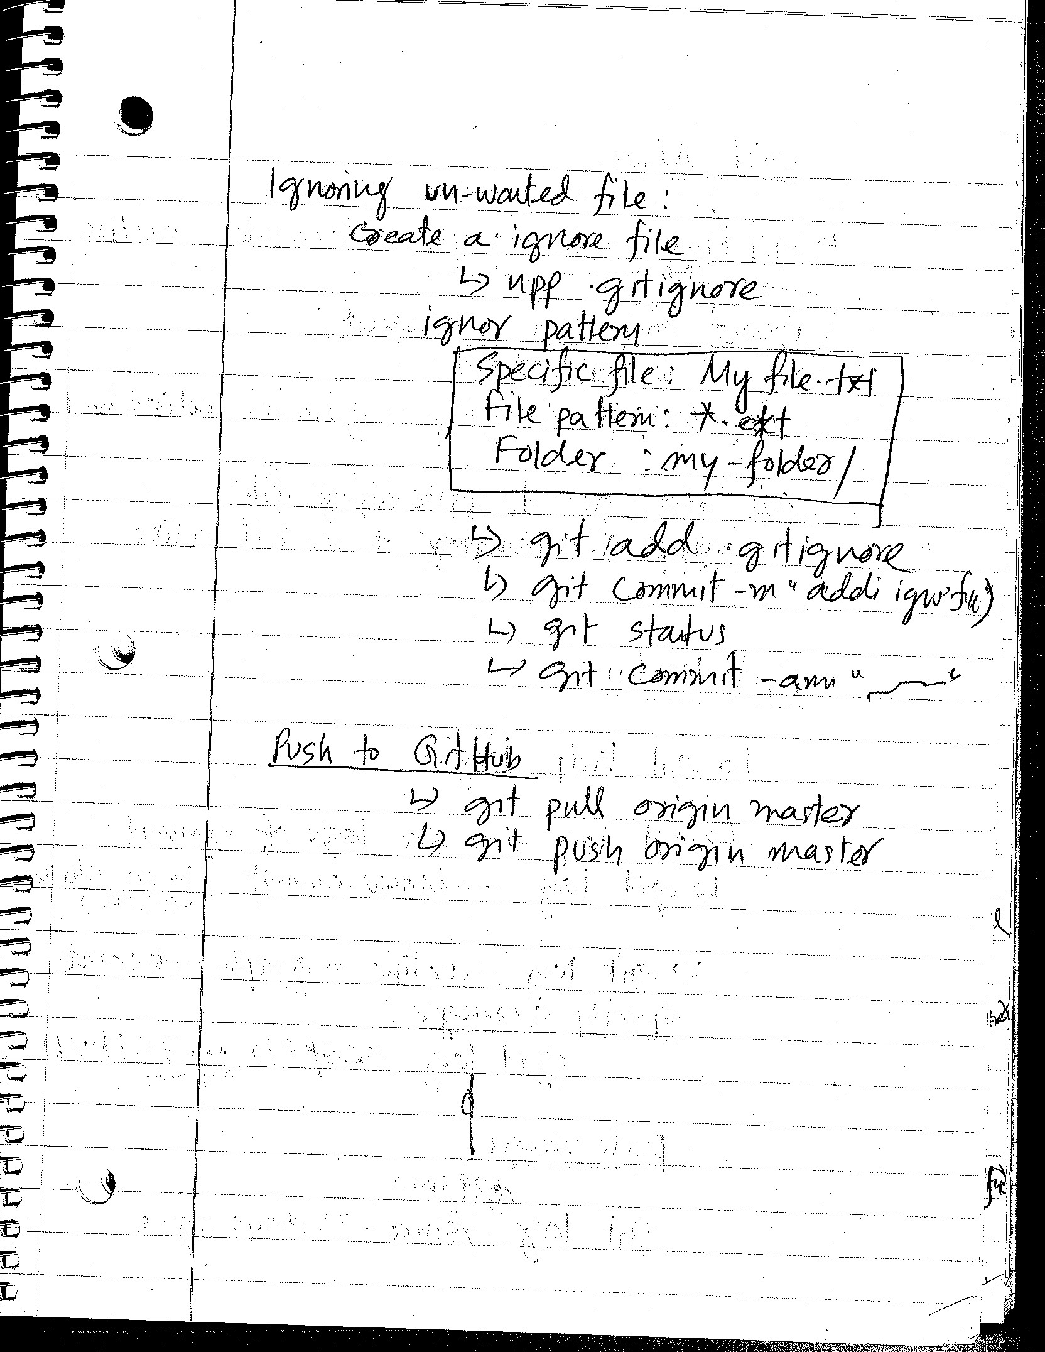
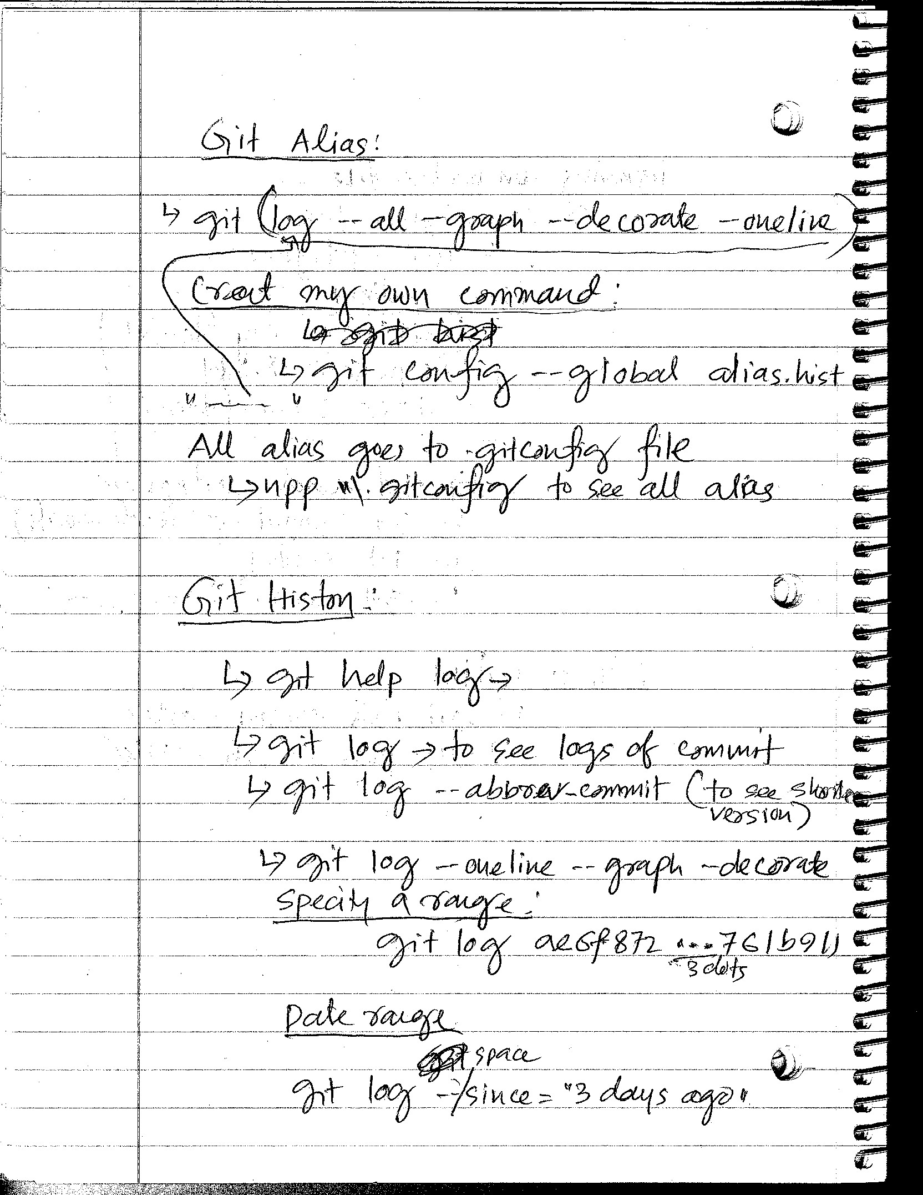

Slide 9
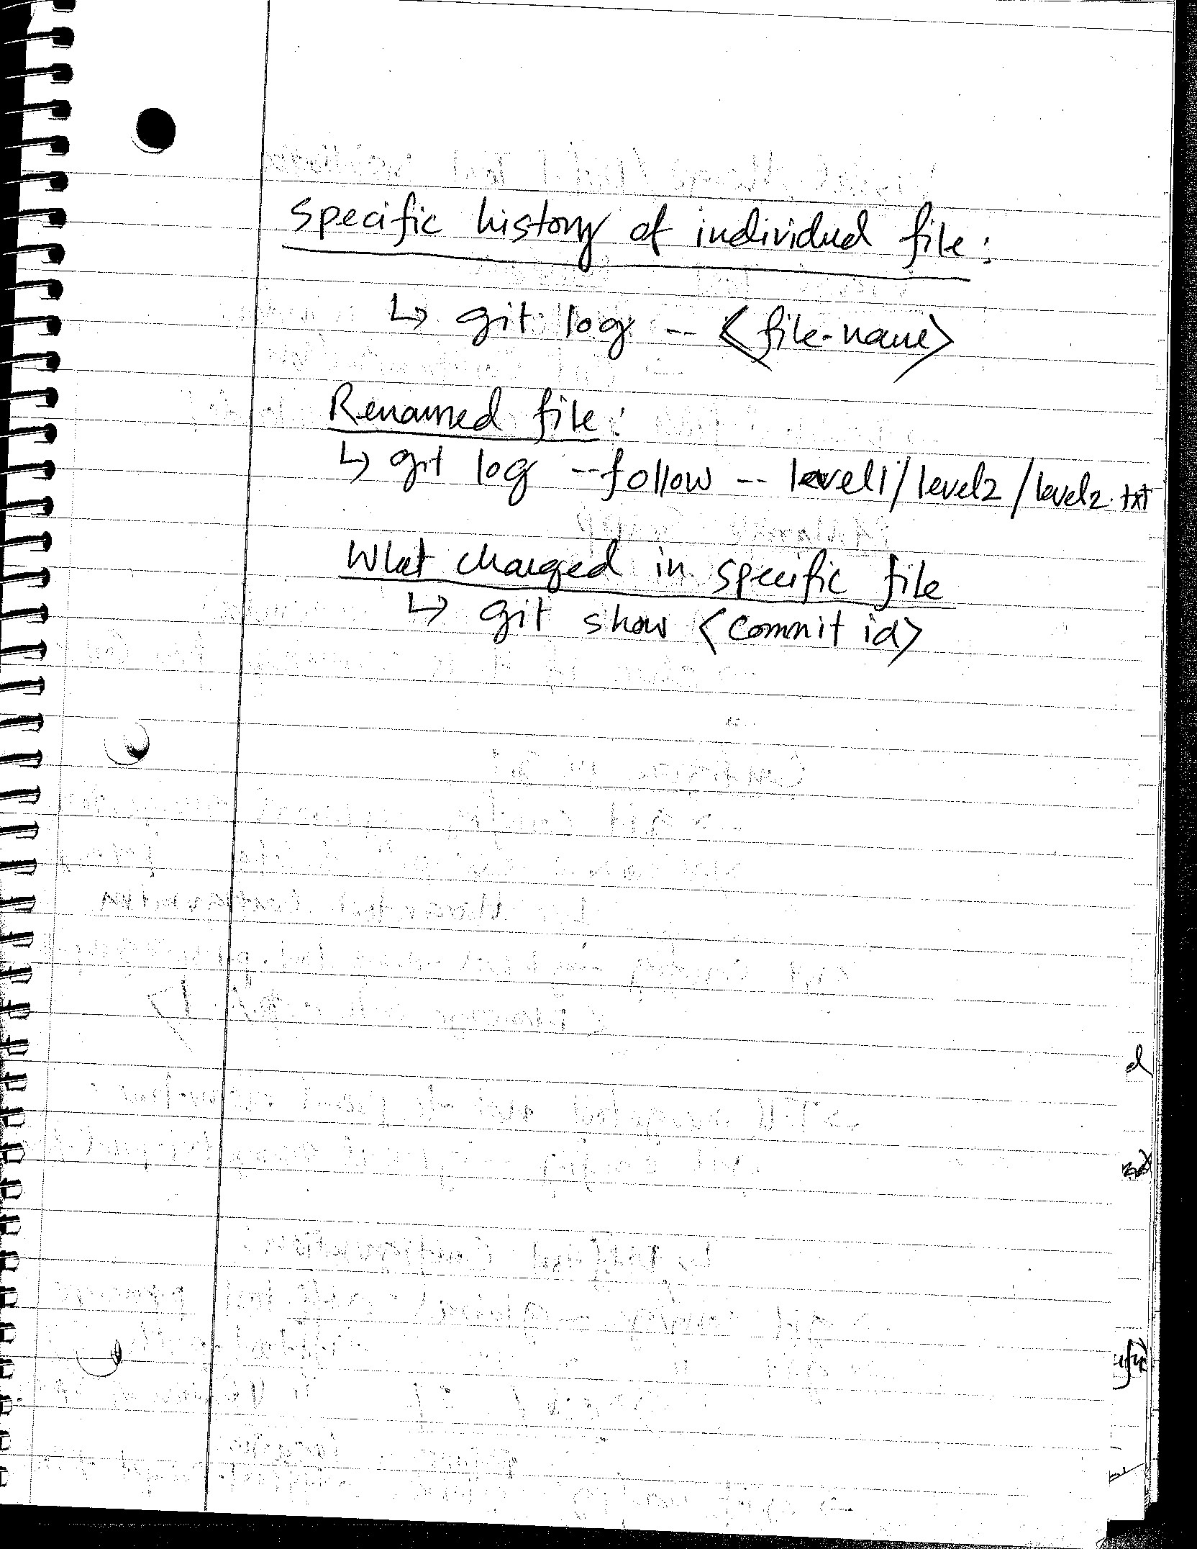
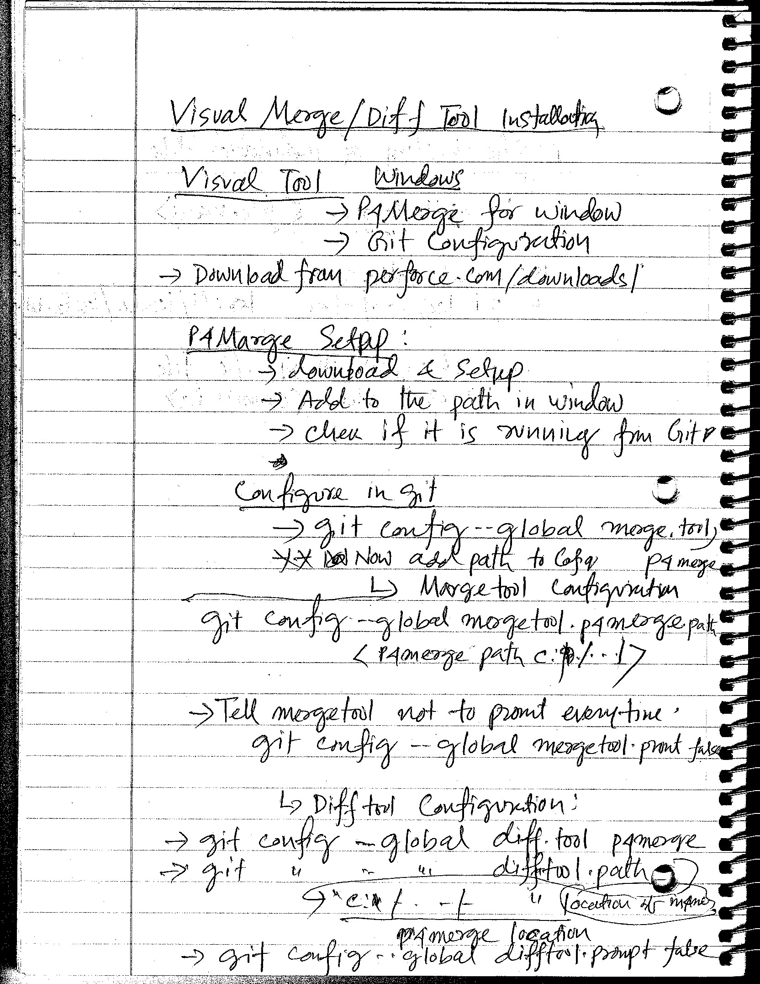

Slide 10
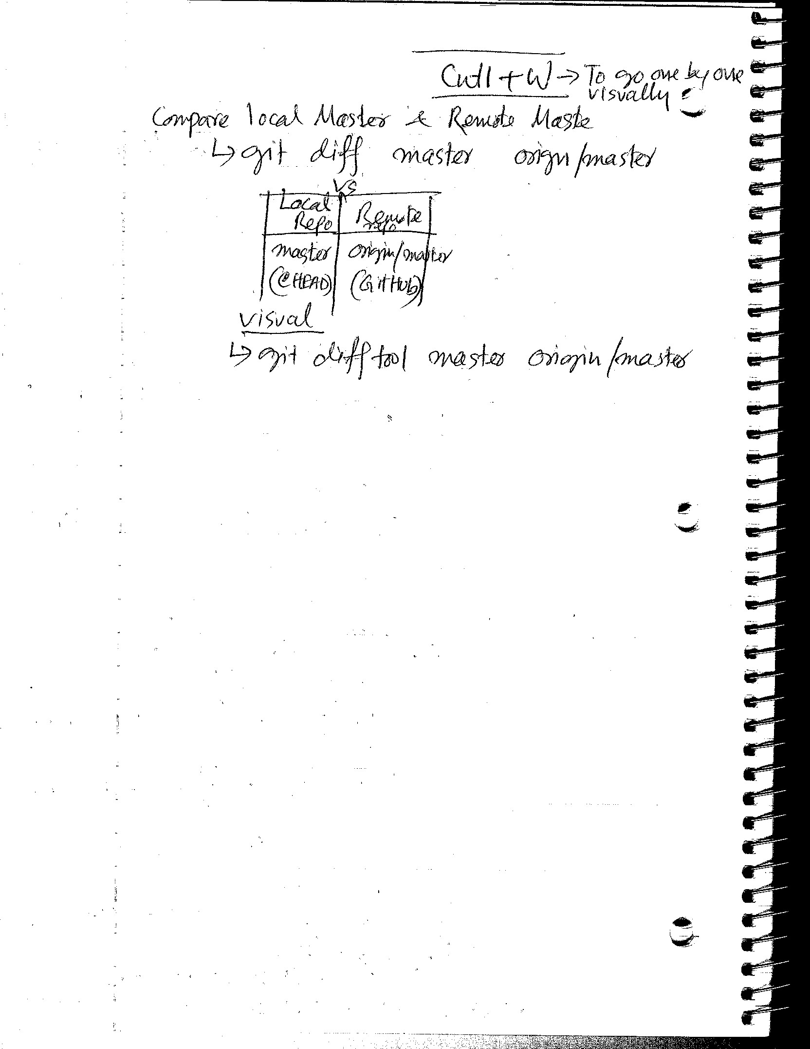
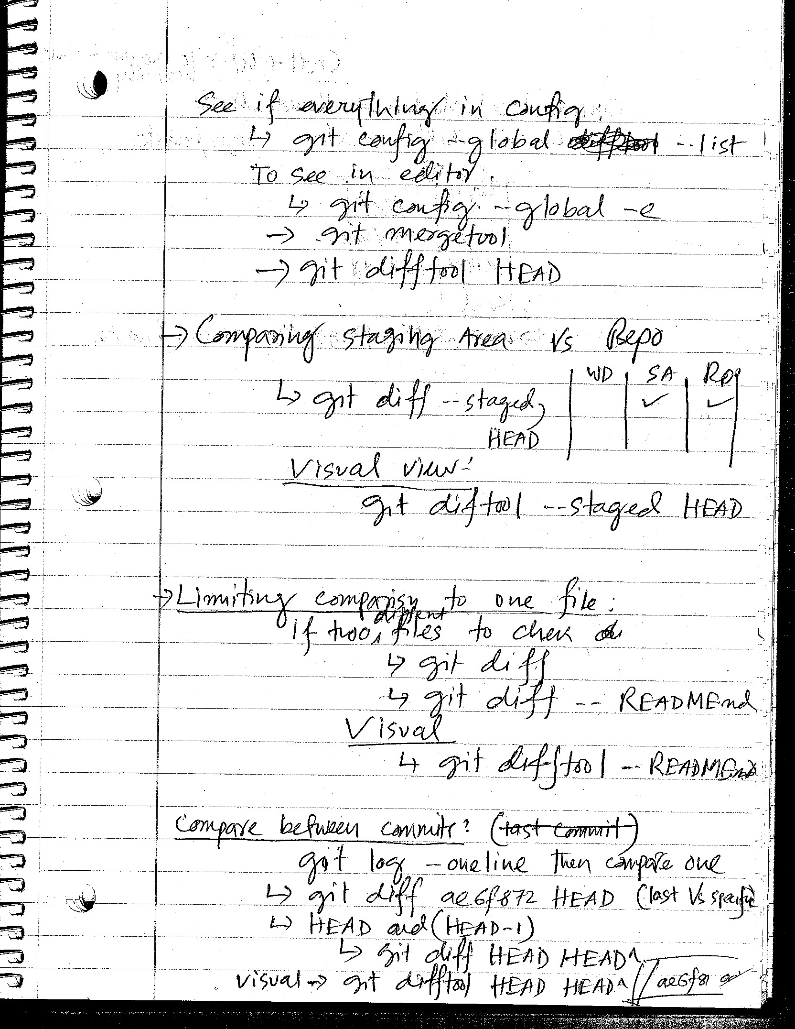

Slide 11
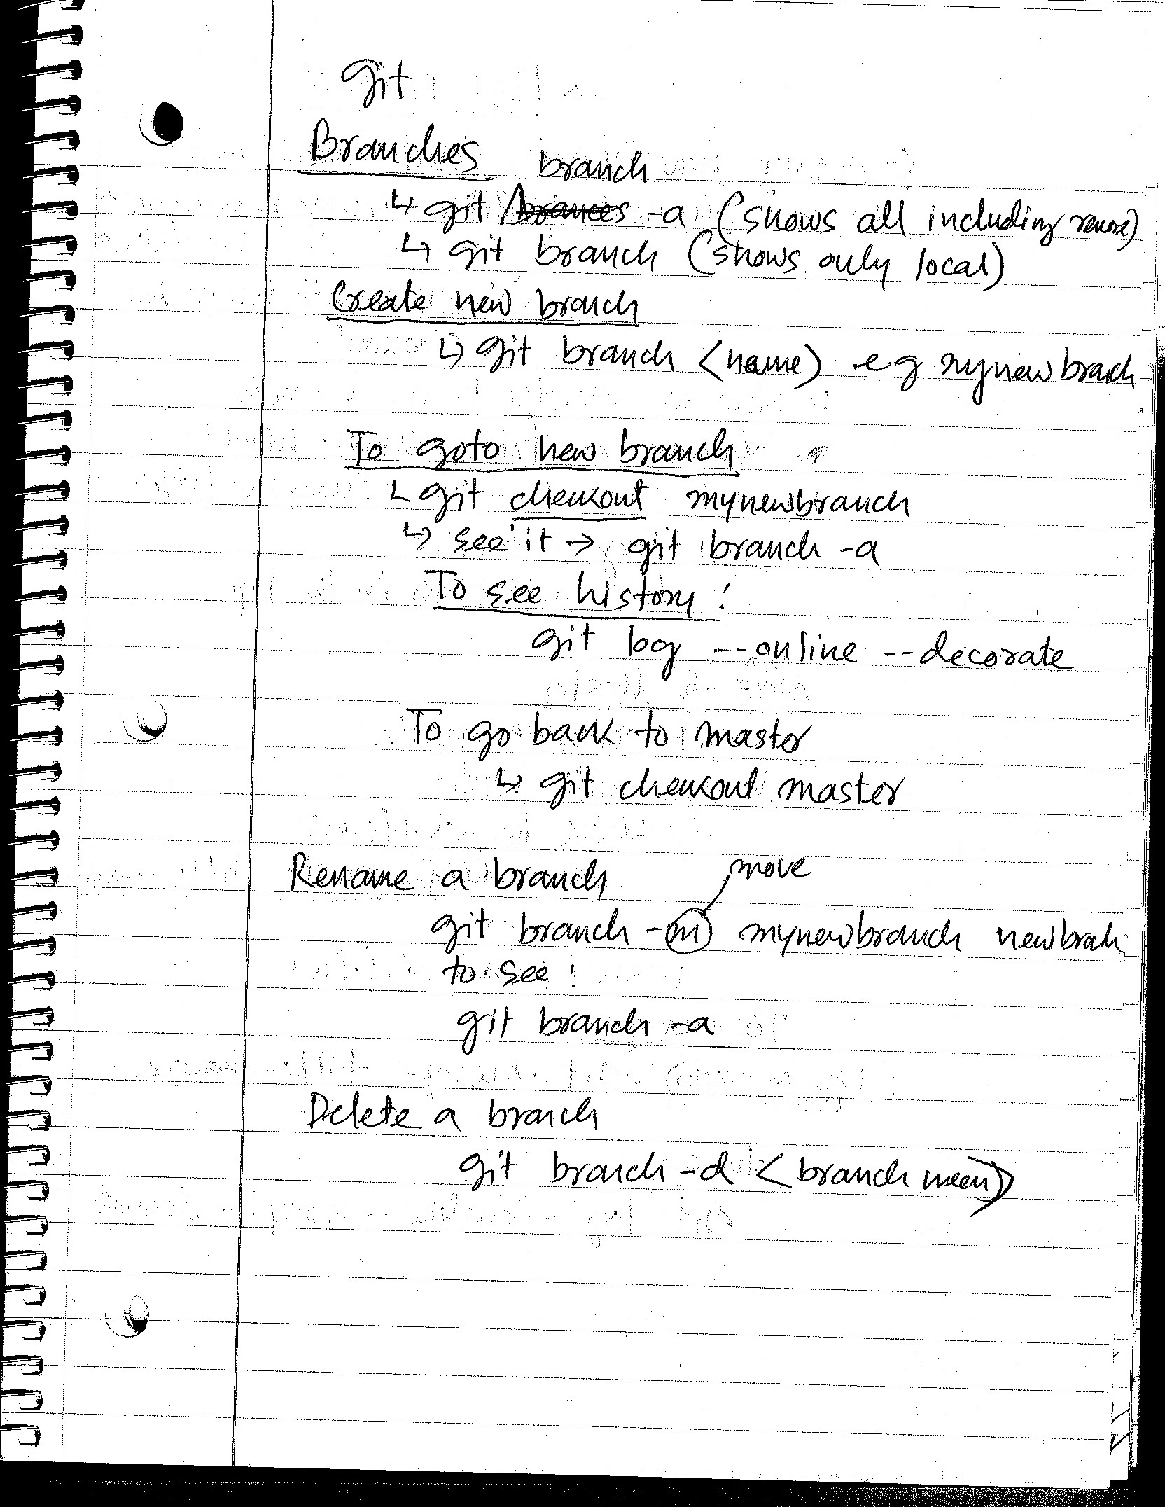
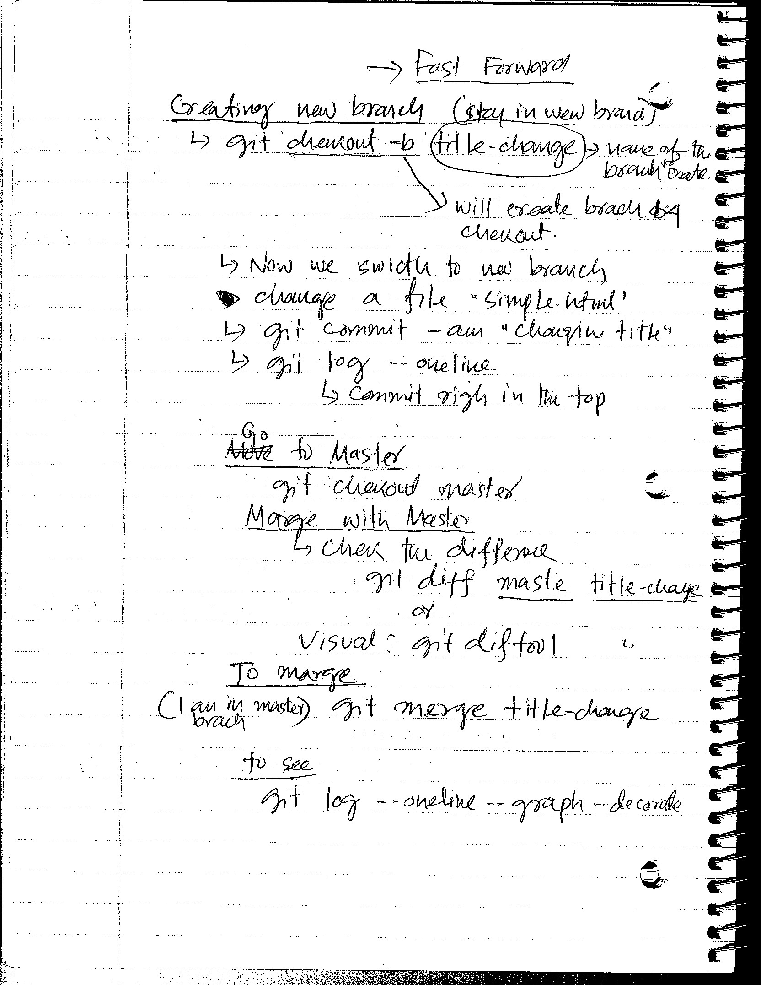

Slide 12
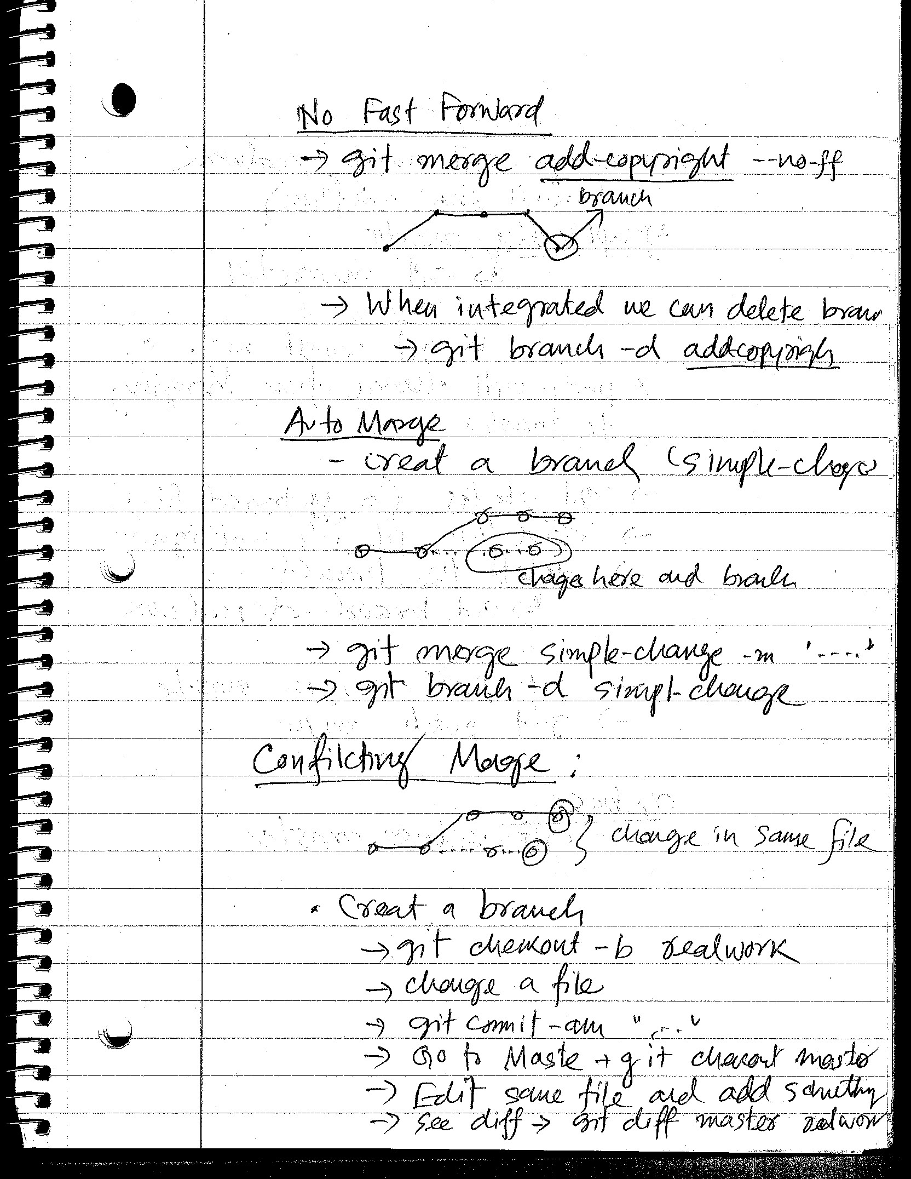
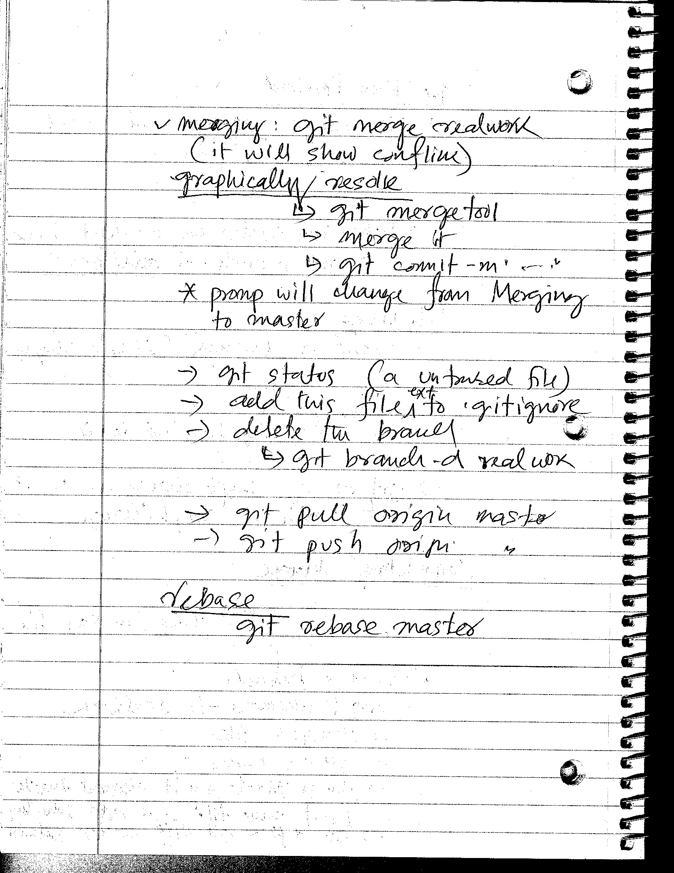

Slide 13
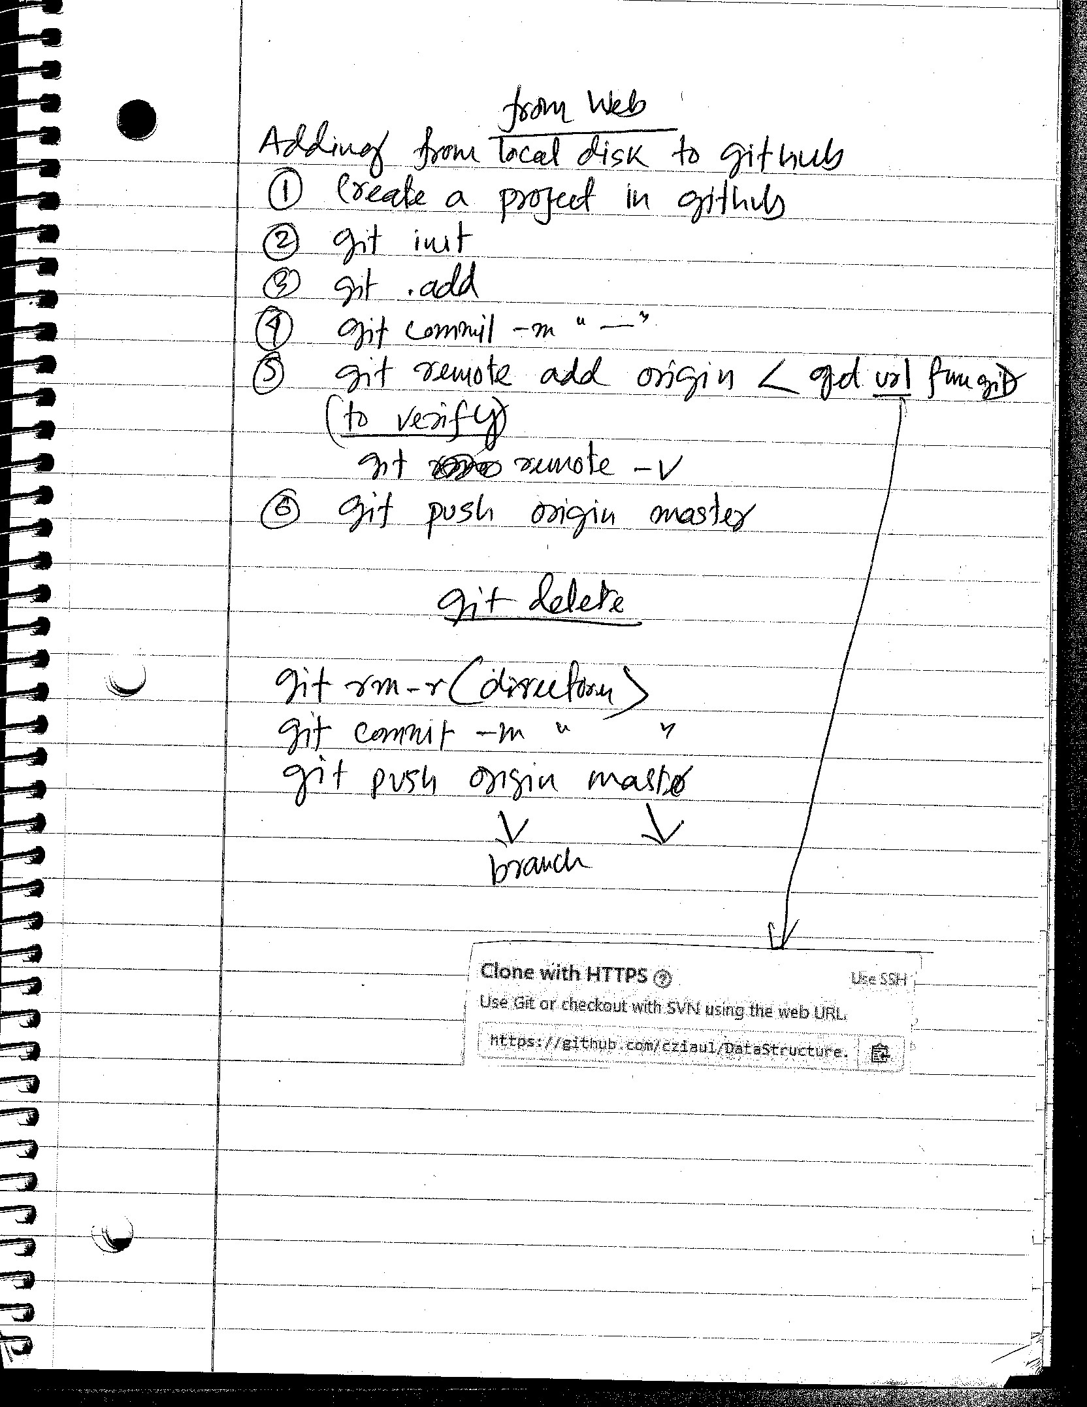
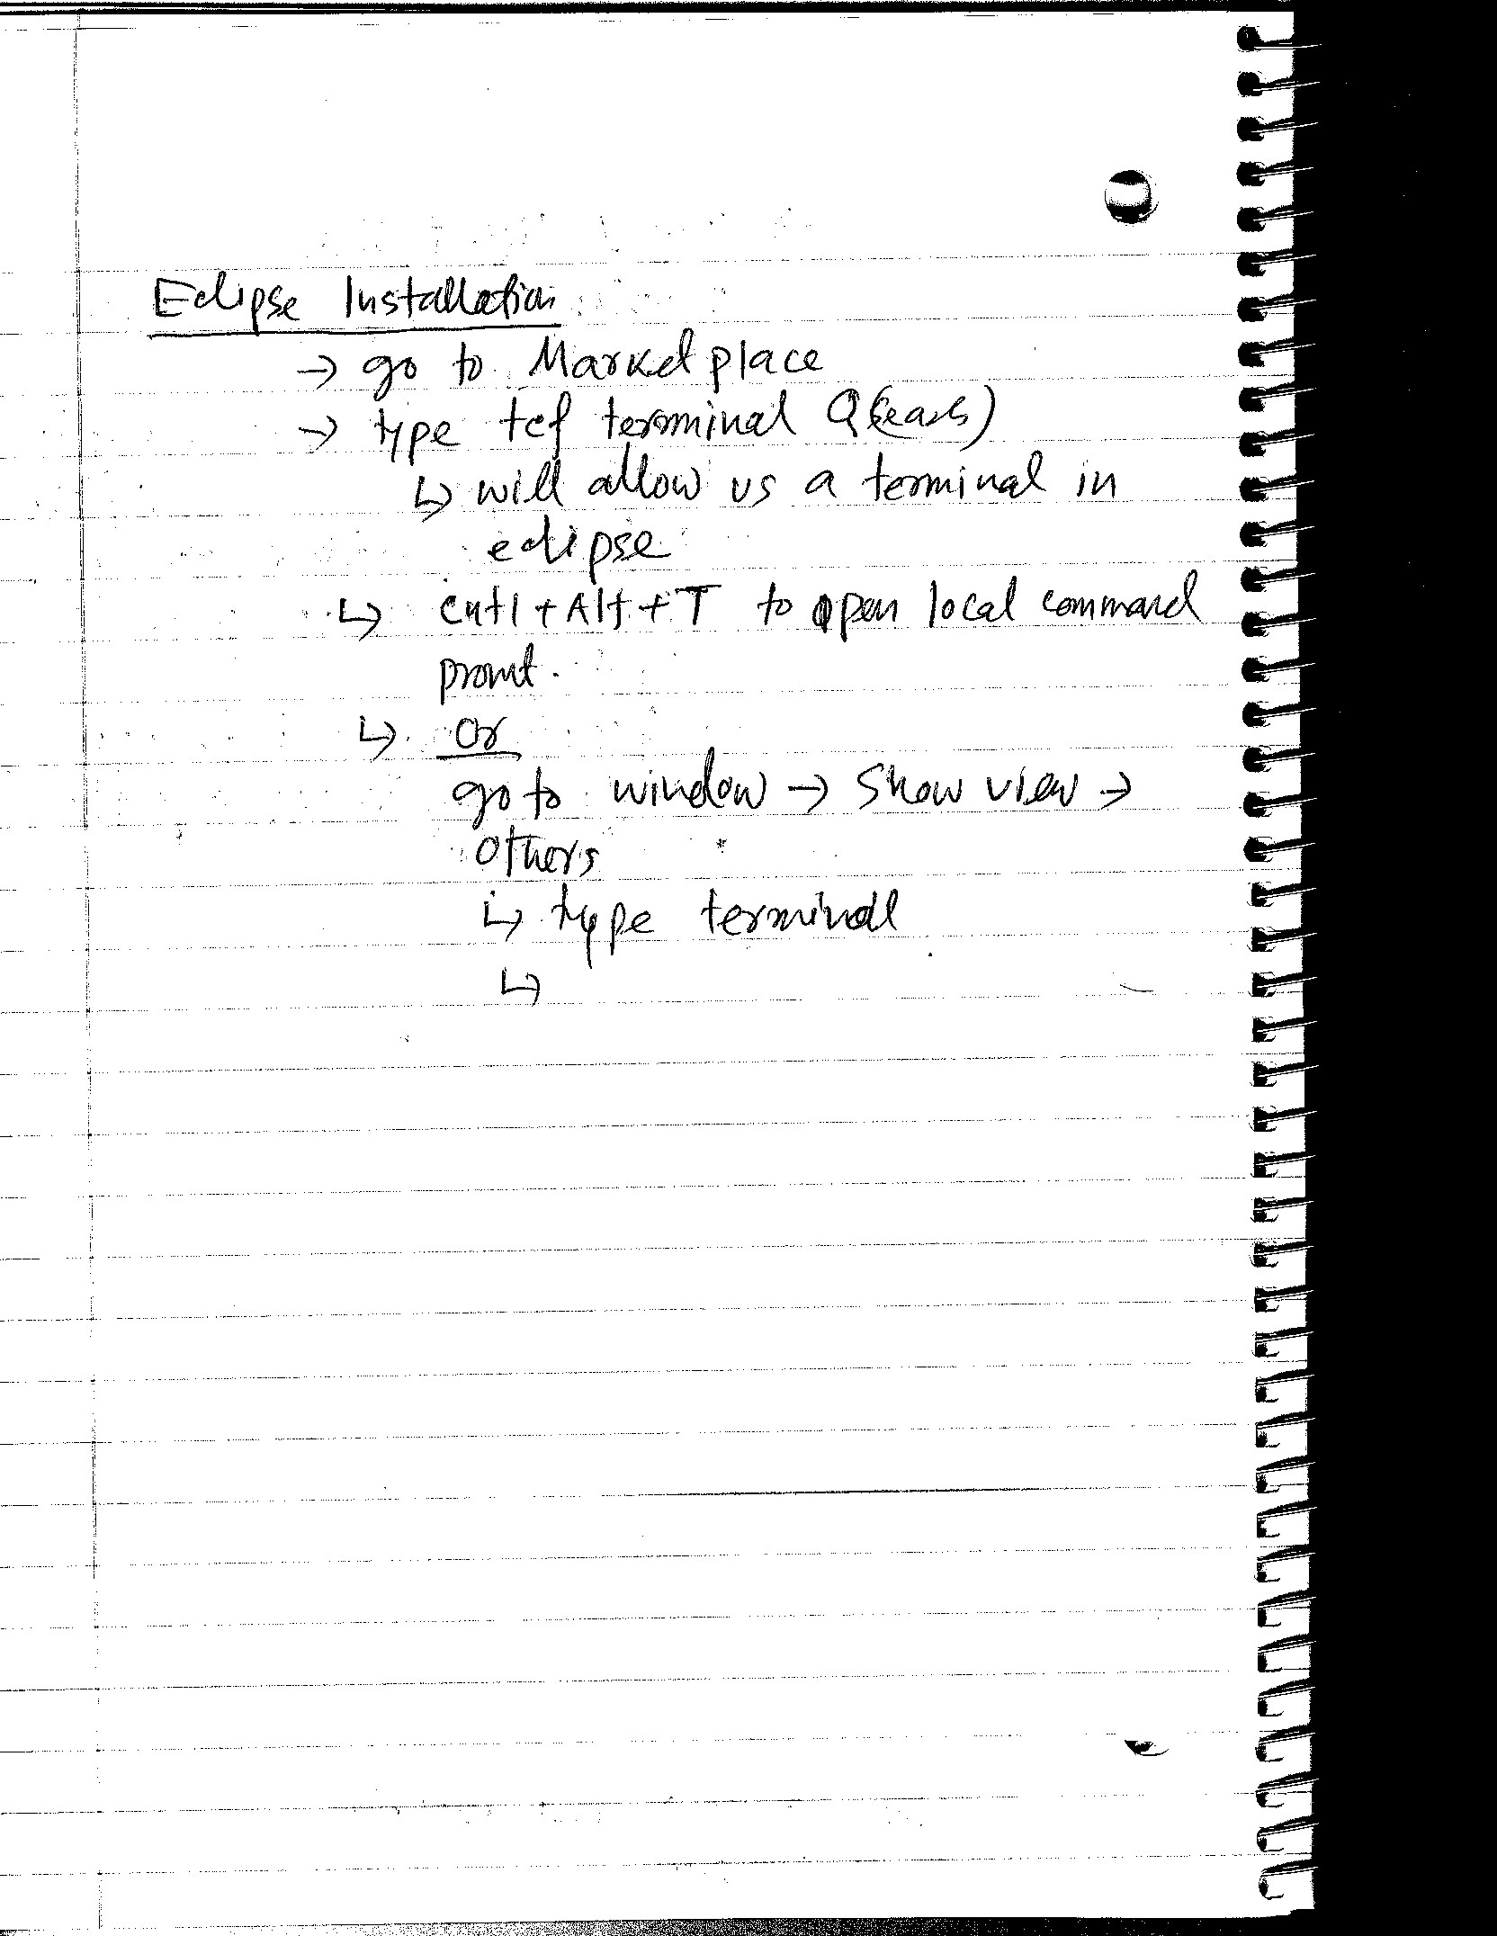

Slide 14
Maven

Slide 15
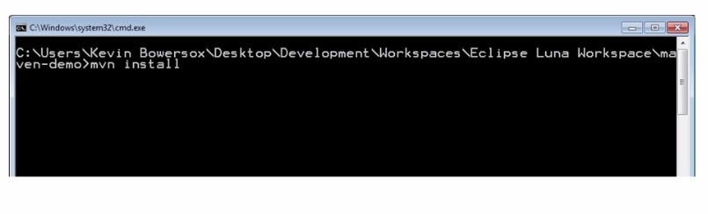
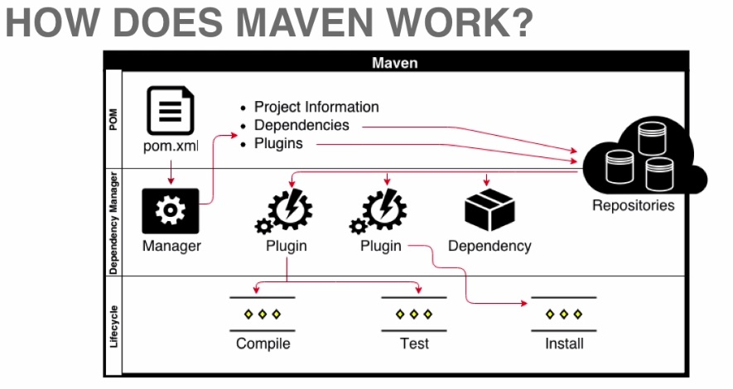
POM : Project Object Model
Maven reads the pom.xml file to build a project.
Project Information
Dependencies (that we need for the project)
Plugins (has goals/lifecycle phases like ‘compile’, ‘Test’, ‘Install’)
Maven uses Dependency Manager to obtain dependencies. It looks into dependencies and plugins listed within the POM, and then it goes out to different repository (local and remote)
Eclipse Installation
In eclipse go to Marketplace
Type ‘tcf terminal’, this will allow us a terminal in eclipse
Cntl+Alt+T to open local command
Or Windows -> Show view -> Others
Type ‘Terminal’
Install it.
What exactly happens when we use above command

Slide 16
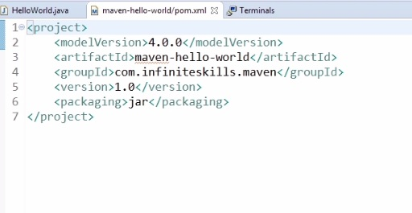
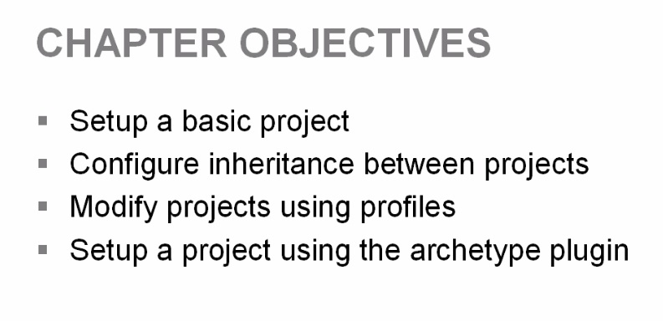
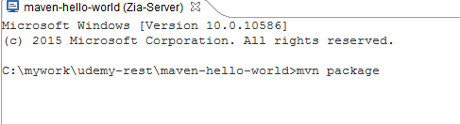
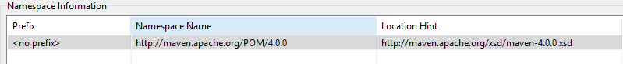
Chapter 1
What version of object model POM is using
Name of the artifact that we are going to generate.
We use these two to pull dependencies
Unique identifier
Jar, War or Ear, default is jar, if we don’t include anything.
Default lifecycle
Setup a Basic Project
Create a Java Project in eclipse
Delete existing src
Create new src (e.g. src/main/java
Selecting project name, create new xml file and name it pom.xml
Select “Create XML file from an XML schema file
Next, Select XML Catalog entry and choose http://maven.apache.org/xsd/maven-4.0.0.xsd
Next, delete Prefix p by editing Namespace Information

Slide 17
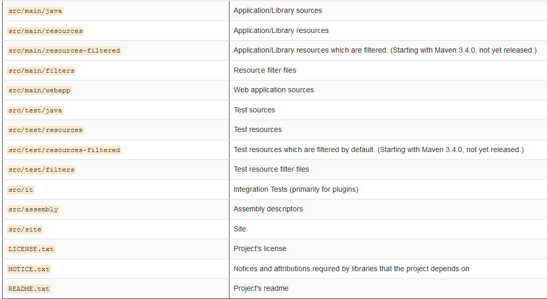
mvn site -> will create a web site for us and will take all info from pom.xml
It will create a directory called “site” and will put all css, images and htmls
Get all standard Directory Layout from http://maven.apache.org/guides/introduction/
Web Application
For Junit or other Test

Slide 18
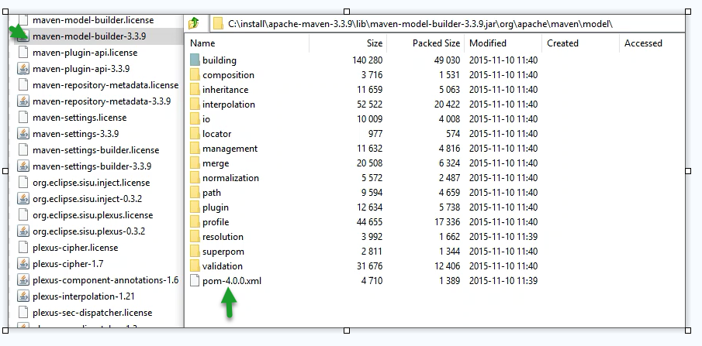
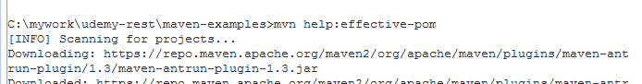
POM file has inheritance like Java
Unlike Java, in child POM we can overwrite
To see all POM info including super POM

Slide 19
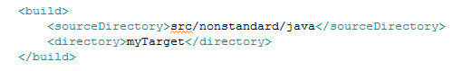
To compile to different folder it can be also absolute path like c:\<folder>\<folder>
Each time we build, our jar file is going to be in this specific directory,
Inheritance
We can place all boilerplate info to parent POM such as dev info, company info etc.
Then add <parent></parent> tag and add <artifactID>, <groupId> and <version> in order to child to inherit from parent.
Then run parent POM (from Parent project run mvn install) in order to register in local repository
Run mvn help:effective-pom to see parent is registered in local repo.
mvn clean -> to clean project
mvn package -> to create jar file (without profile)
Profile
In real world we work for different environments. Maven ‘Profile’ allows us to set different properties for different environments.
mvn –production package (specifying mvn – profile goal)
Activator (determines which profile to run)

Slide 20
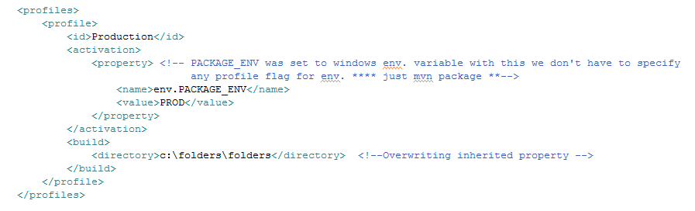
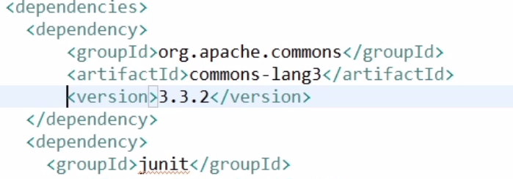
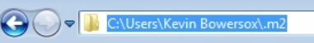
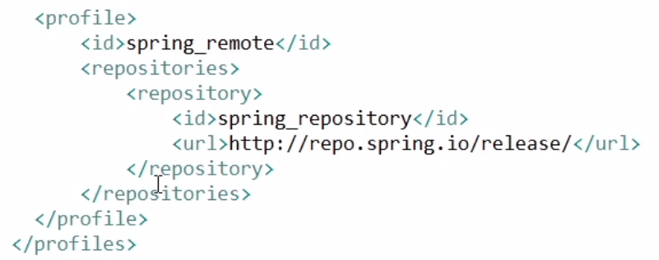
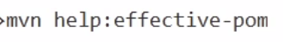
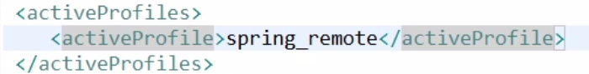
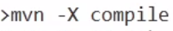
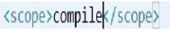
How to create a maven project very quickly using archetype
In Maven there is a archetype plugin and that as generate goal
mvn archetype:generate (when we execute this command it will install all archetype related files and will ask for setup (L 17)
It will create a default project with pom file and src directory
To make it eclipse project type mvn eclipse:eclipse
Archetype are pre-defined projects like templates
Dependency Management (search.maven.org -> maven central repo)
Basic Dependency,
mvn dependency:copy-dependencies -> this will pull dependency to our local repo.
For updating version just update
The version and run below
To get this dependency to eclipse type mvn eclipse:eclipse
Transitive Dependency (Dependence of dependency),
Connect to alternative remove repo.
mvn help:effective-pom -> shows remote repo where maven is getting jar files from
To add alternative repo go to maven installed folder->apache-maven-3.2.5->conf> and edit settings.xml
In profile section and use example there to use repository (L 21)
Understand dependency scope. (L22)

Slide 21
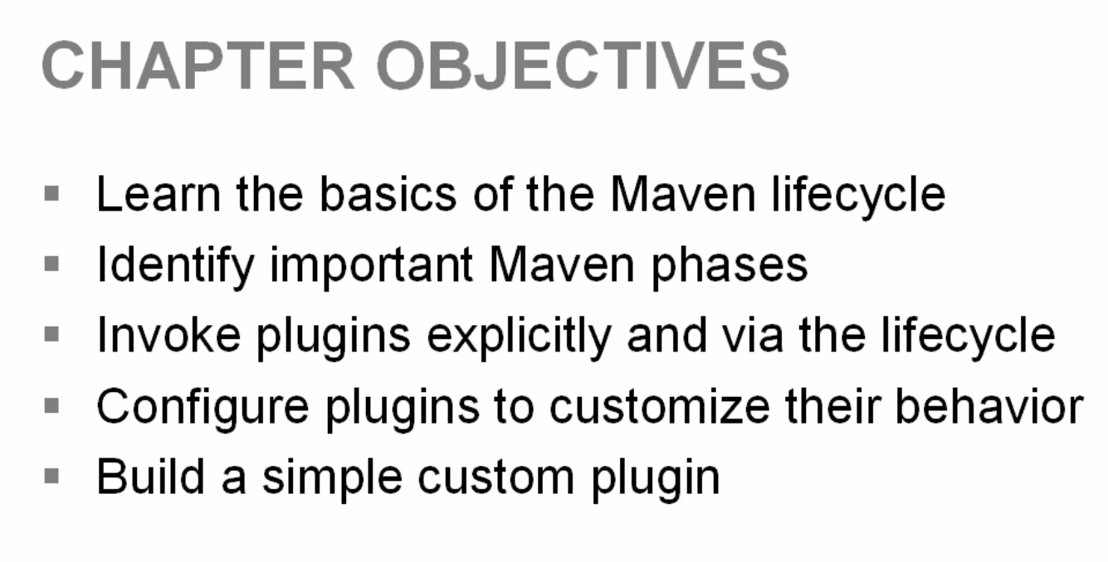
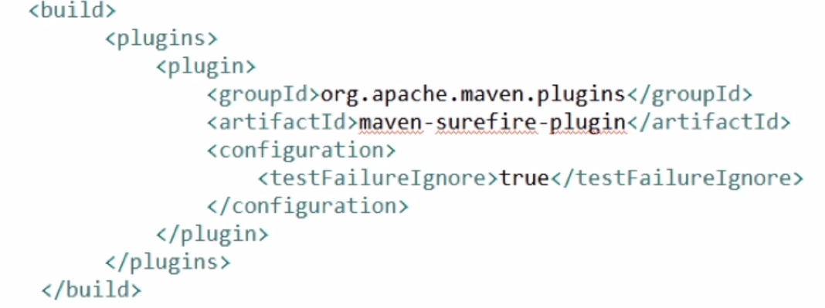
There are 3 lifecycles 1. Default 2. Clean 3. Site and these has individual phases
Default (it has 23 phases)
> mvn help:describe –Dcmd=deploy (deploy phase of default liyfecyle)
We can also run multiple phases like > mvn clean install
Important phases
Compile (Turns Java file to class file)
Test-compile (This will compile our all unit test)
Test (For particular unit test)
Package (compiles and package it in its distributed format like jar, war or ear)
Install (Takes #4 and puts in our local repo, this will allow other artifacts to depend
on this artifacts )
Deploy
Clean >mvn help:describe –Dcmd=clean
This will show clean lifecycle phases (e.g. pre-clean, clean, post-clean)
Goals (Like method in a class)
Goals preforms tasks
Plugins ( Comprise of number of goals) – like class (L 27)
mvn compiler:compile (Plugins : goals)
mvn help:effective-pom (shows all plugins)
mvn help:describe –Dplugin=compiler -> Describing the complier plugin
mvn compiler :help –Ddetail = true –Dgoal=compile

Slide 22
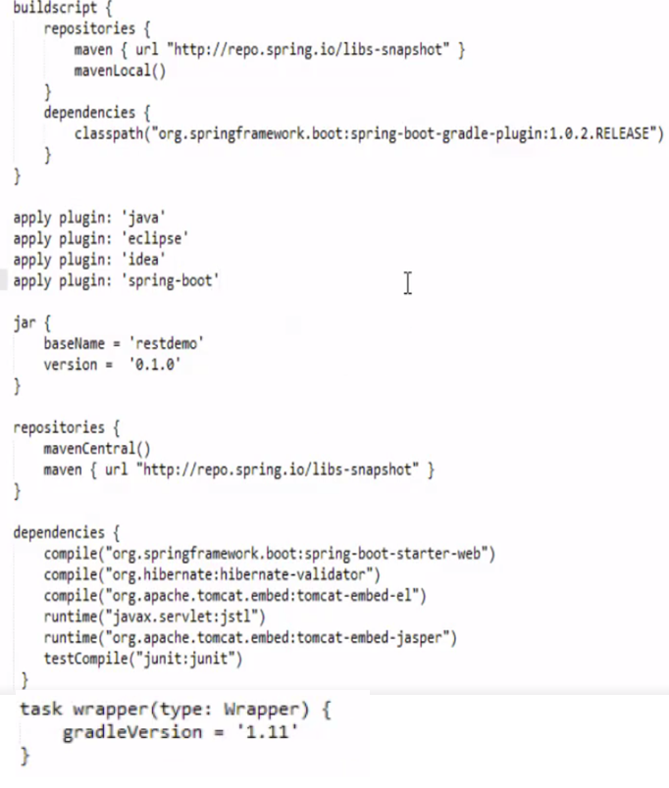
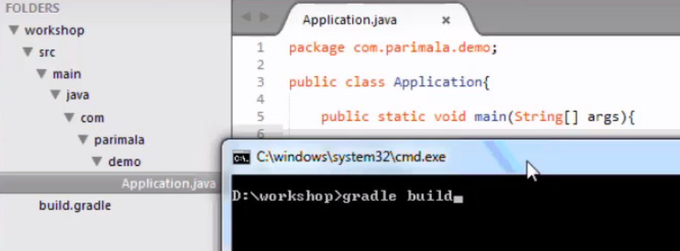
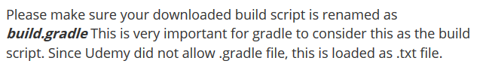
Gradle

Slide 23
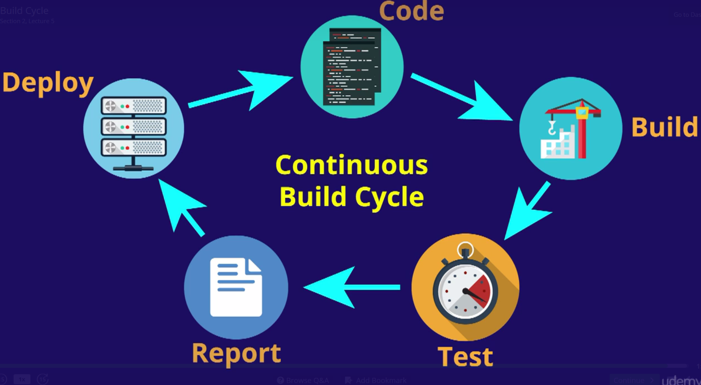
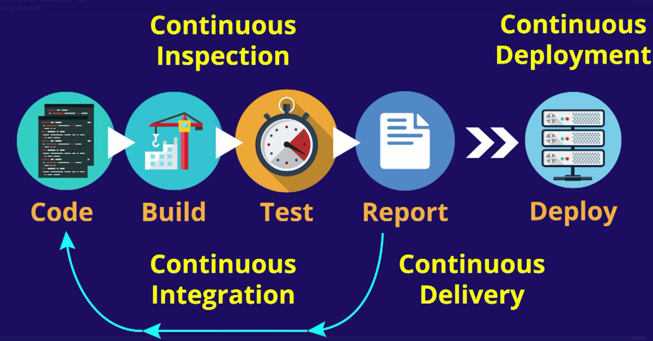

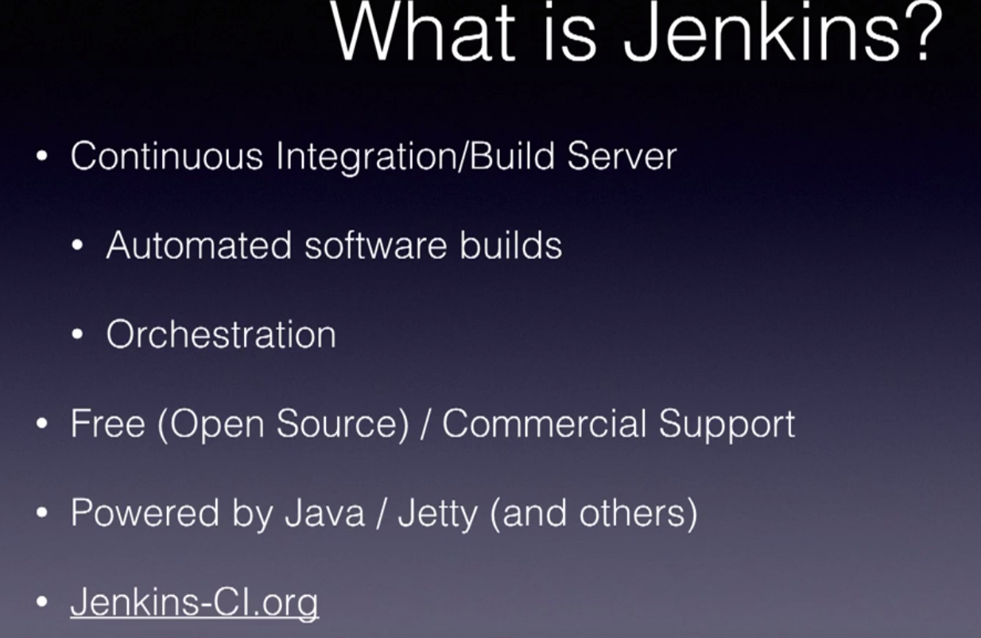
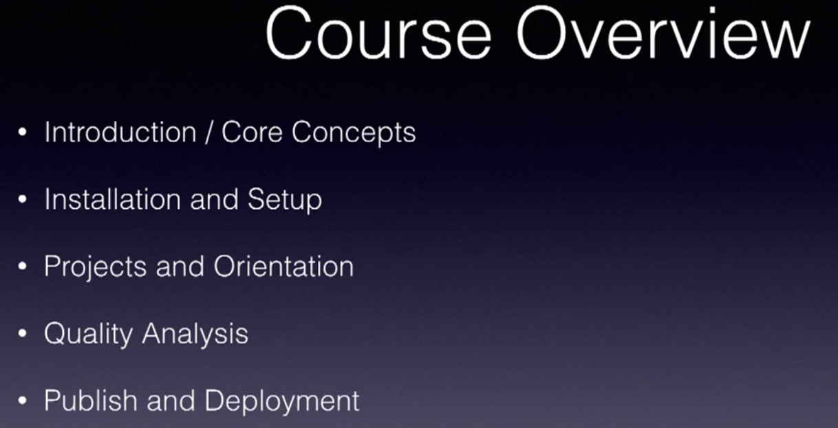


Jetty should be run on JDK not on JRE so that it has access JDK tools when needed
View Provides a nice way to group project and folder together
Projects also known as jobs provides configuration or instruction for how to build the software.
When ready project will queue up until there is available build Executor ready to execute the project’s build, which will communicate various tools like shell and/or Maven

Slide 24




Slide 25


Since we linked Gibhub it should now show up

Slide 26


Slide 27







Will check if any change, if so run the build

Slide 28


Slide 29









Slide 30



Setup
2
Install
1
3
4

